Slide 1
PAUL’S FOUR MAJOR ACCOMPLISHMENTS
Fought the good fight
Finished the RACE
Kept the faith
Gained the crown of righteousness
For I am already being poured out as a drink offering, and the time of my departure is at hand. I have fought the good fight, I have finished the race, I have kept the faith. Finally, there is laid up for me the crown of righteousness, which the Lord, the righteous Judge, will give to me on that Day, and not to me only but also to all who have loved His appearing. 2 Timothy 4:6-8
Richard Thetford www.thetfordcountry.com

Slide 2
Fought the good fight
“War the good warfare”
Not a carnal war – a spiritual one
2 Corinthians 10:4-5
Ephesians 6:11-18
Richard Thetford www.thetfordcountry.com

Slide 3
Fought the good fight
The Christian’s armor:
Truth
John 8:32
Righteousness
Philippians 3:9
Peace
Philippians 4:4-7
Richard Thetford www.thetfordcountry.com

Slide 4
Fought the good fight
The Christian’s armor:
Faith
Romans 10:17
Salvation
Acts 2:38
Word of God
2 Timothy 3:16; Matthew 4:3-4
Richard Thetford www.thetfordcountry.com

Slide 5
Fought the good fight
The Christian’s armor:
Prayer
James 5:16
Paul’s warfare that he fought was both defensive and offensive
Philippians 1:17
Acts 20:20
Richard Thetford www.thetfordcountry.com

Slide 6
Fought the good fight
Paul was a good soldier of Christ
Well disciplined – Hebrews 5:8-9
Willing to sacrifice – 2 Cor 11:23-28
Steadfast – 1 Corinthians 15:58
Faithful unto death – Revelation 2:10
Richard Thetford www.thetfordcountry.com

Slide 7
Finished the race
Paul finished!
The Christian’s race:
1 Corinthians 9:24-27
2 Timothy 2:5
Hebrews 12:1
Exercise self-control
Contend according to the rules
Lay aside hindrances
Finish the race
Richard Thetford www.thetfordcountry.com

Slide 8
Kept the faith
Beloved, while I was very diligent to write to you concerning our common salvation, I found it necessary to write to you exhorting you to contend earnestly for the faith which was once for all delivered to the saints. Jude 3
Organized body of truth called “the faith”
“the faith” is complete
Galatians 1:7-9
“the faith” is the authority of God to men
1 Corinthians 1:21; Romans 1:16
Richard Thetford www.thetfordcountry.com

Slide 9
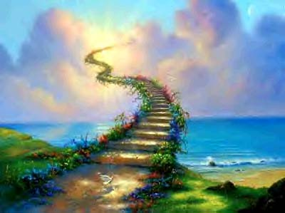
Gained the crown of righteousness
The Lord promises the crown of life to the faithful
Revelation 2:10
1 John 2:25
1 Timothy 6:12
This crown was not promised to Paul only, but
“also to all who have loved His appearing.”
Richard Thetford www.thetfordcountry.com

Slide 10
PAUL’S FOUR MAJOR ACCOMPLISHMENTS
These Four accomplishments should serve as an inspiration for each one of us
Fight the good fight
Finish the race
Keep the faith
Look forward to the crown of righteousness
Richard Thetford www.thetfordcountry.com

