Slide 1
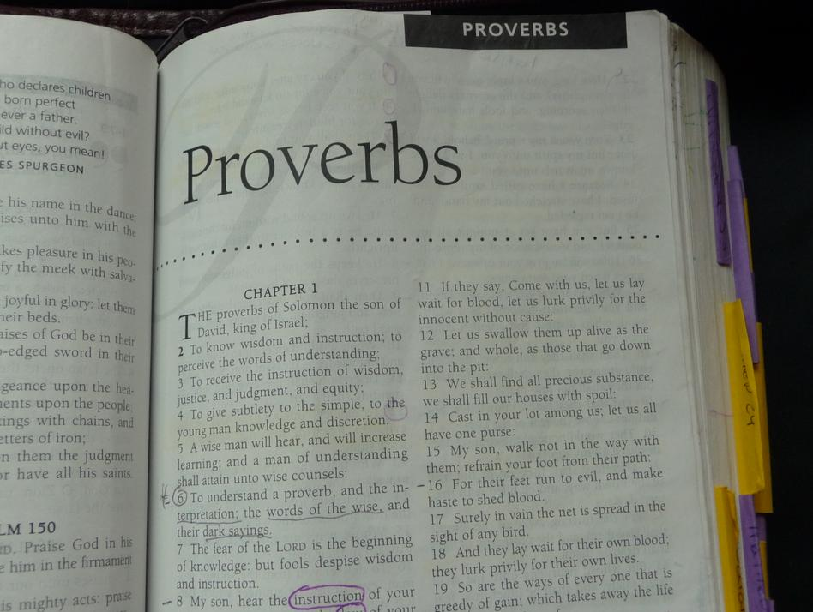
Putting the Proverbs to Use
Richard Thetford www.thetfordcountry.com

Slide 2
Facts on Proverbs
Proverb means “parallel” or “similar”
Proverb is “a description by way of comparisons”
A wise son heeds his father’s instruction, but a scoffer does not listen to rebuke.”
Proverbs 13:1
Richard Thetford www.thetfordcountry.com

Slide 3
Facts on Proverbs
Proverbs is classified as “wisdom literature”
A proverb is defined as “a short, self-evident statement”
“The fear of the LORD is the beginning of knowledge, but fools despise wisdom and instruction”
Proverbs 1:7
A catchy way of expressing a truth for remembrance
Richard Thetford www.thetfordcountry.com

Slide 4
Facts on Proverbs
Proverbs is a distinct philosophy of life
Proverbs 1:10
Capsules of wisdom from those who knew the law of God
Generally true, but not absolute in every case
“Train up a child in the way he should go, and when he is old he will not depart from it”
Proverbs 22:6
Richard Thetford www.thetfordcountry.com

Slide 5
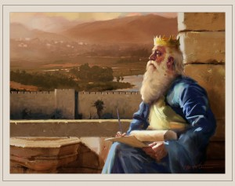
Facts on Proverbs
Book is made of many Proverbs
Solomon’s
Spoke 3,000 proverbs
1 Kings 4:32
Wisdom to speak was a direct gift from God
1 Kings 4:29-31
Richard Thetford www.thetfordcountry.com

Slide 6
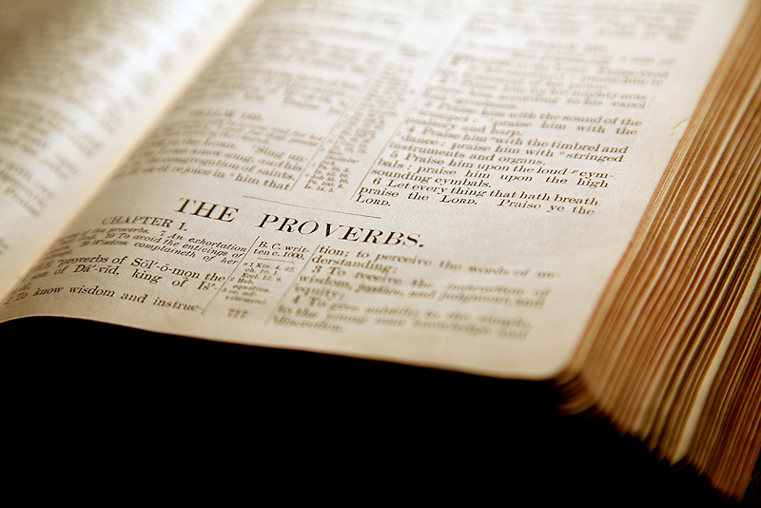
Facts on Proverbs
Book is made of many Proverbs
Solomon’s
His proverbs fall into two categories
Those he personally arranged
Chapters 1-24
Those arranged by scribes of Hezekiah’s time
Chapters 25-29
Agur (c. 30)
Lemuel (c. 31)
Richard Thetford www.thetfordcountry.com

Slide 7
Facts on Proverbs
Purpose of the Book
To impart wisdom
Proverbs 1:1-6
“the best guide book of success a young man can follow”
Key thought
“the fear of the Lord” (14 times)
Richard Thetford www.thetfordcountry.com

Slide 8
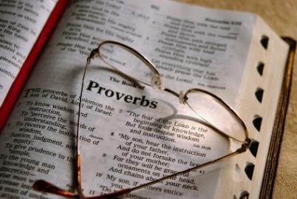
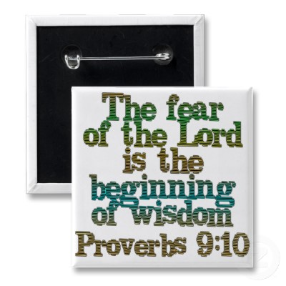
Facts on Proverbs
Theme of the book is “wisdom” (104 times)
Wisdom comes from God
James 1:5
Proverbs 9:10
Richard Thetford www.thetfordcountry.com

Slide 9
Facts on Proverbs
Theme of the book is “wisdom” (104 times)
Three things needed to attain true wisdom:
Available revelation from God
Proverbs 2:6
A seeking heart
Proverbs 2:1-5
A submissive life
Psalms 119:100
Richard Thetford www.thetfordcountry.com

Slide 10
Facts on Proverbs
The Bible defines wisdom in terms of one’s relationship with God rather than one’s formal education
The book of Proverbs shows the tremendous value of wisdom!
Richard Thetford www.thetfordcountry.com

