Slide 2
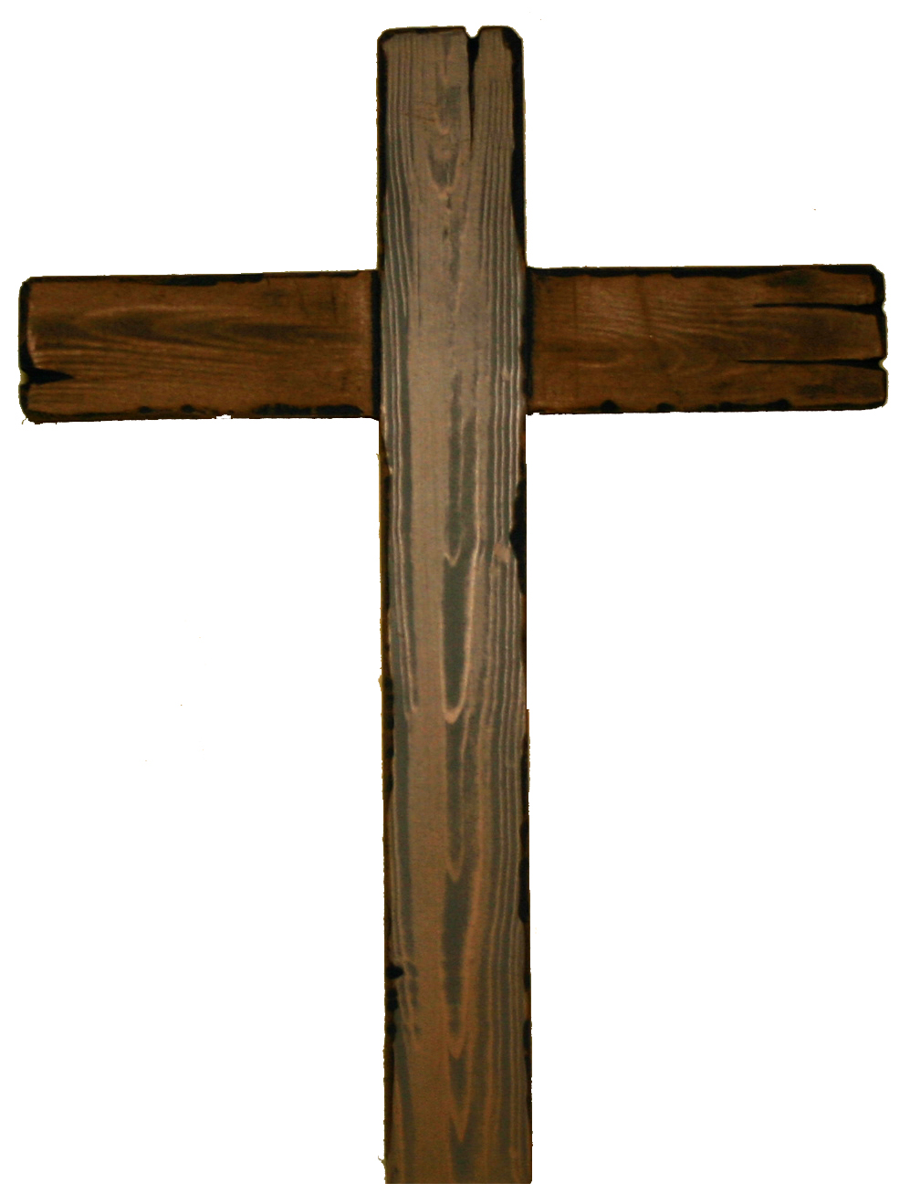
Rooted in Love
Love begins with God
Love of God
John 3:14-16
God is love
1 John 4:8-10
God’s children
1 John 3:1-2
Jesus gave His life
Ephesians 3:1-2
1 John 3:16
We were sinners
Romans 5:6-8
Richie Thetford www.thetfordcountry.com

Slide 3
Rooted in Love
The Nature of God’s Love
Surpasses knowledge
Ephesians 3:17-19
Mercy and grace
Ephesians 2:4-9
Suffers long
1 Corinthians 13:4-8
Does no harm
Romans 13:8-10
Richie Thetford www.thetfordcountry.com

Slide 4
Rooted in Love
Our Response to God’s Love
To love Him
Matthew 22:36-40
Obey His commands
John 14:15
John 14:21
1 John 5:2-3
Richie Thetford www.thetfordcountry.com

Slide 5
Rooted in Love
Our Response to God’s Love
We will reflect His Son
2 Corinthians 5:14-15
Love one another
1 John 4:7-11
Richie Thetford www.thetfordcountry.com

Slide 6
Love Him and Obey Him
Richie Thetford www.thetfordcountry.com

