Slide 1
Striving Together for the Faith
“Only let your conduct be worthy of the gospel of Christ, so that whether I come and see you or am absent, I may hear of your affairs, that you stand fast in one spirit, with one mind striving together for the faith of the gospel” Philippians 1:27

Slide 2
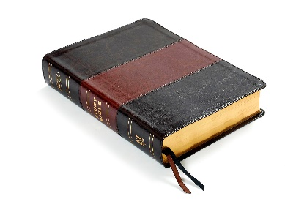
Introduction
Division
1 Corinthians 1:11-12
1 Corinthians 3:3-4
Strive Together – in the work
1 Corinthians 15:58
2 Timothy 2:15
Strive Together – to be unified
Philippians 1:27

Slide 3
Meaning of Striving Together
Involved in fellowship
1 John 1:3
1 John 5:1
Participate in a “common salvation”
Jude 3; 2 Peter 1:1; 1 Corinthians 1:10 Ephesians 4:2-3; Colossians 3:14 Nehemiah 4:6; 3 John 8
A spirit of comradery

Slide 4
2 Corinthians 8:23 If anyone inquires about Titus, he is my partner and fellow worker concerning you. Or if our brethren are inquired about, they are messengers of the churches, the glory of Christ.
Philippians 1:3-5 I thank my God upon every remembrance of you, always in every prayer of mine making request for you all with joy, for your fellowship in the gospel from the first day until now.
Philippians 2:25 Yet I considered it necessary to send to you Epaphroditus, my brother, fellow worker, and fellow soldier, but your messenger and the one who ministered to my need.
Philippians 4:3 And I urge you also, true companion, help these women who labored with me in the gospel, with Clement also, and the rest of my fellow workers, whose names are in the Book of Life.

Slide 5
Colossians 4:7 Tychicus, a beloved brother, faithful minister, and fellow servant in the Lord, will tell you all the news about me.
Colossians 4:10 Aristarchus my fellow prisoner greets you, with Mark the cousin of Barnabas (about whom you received instructions: if he comes to you, welcome him).
1 Thessalonians 3:2 and sent Timothy, our brother and minister of God, and our fellow laborer in the gospel of Christ, to establish you and encourage you concerning your faith.
Philemon 1 Paul, a prisoner of Christ Jesus, and Timothy our brother, To Philemon our beloved friend and fellow laborer.
Philemon 23-24 Epaphras, my fellow prisoner in Christ Jesus, greets you, as do Mark, Aristarchus, Demas, Luke, my fellow laborers.

Slide 6
Requirements of Striving Together
Be “sanctified”
John 17:17
Grow toward spiritual maturity
Ephesians 4:11-16
Sensitive regard for others
Romans 14:1-3, 10, 19; 15:1-2
Dedicated to mutual burden-bearing
Galatians 6:1-2

Slide 7
Requirements of Striving Together
Eliminate self-centeredness
Romans 12:10
Philippians 2:3-4
Be motivated by a common vision
And I told them of the hand of my God which had been good upon me, and also of the king’s words that he had spoken to me. So they said, “Let us rise up and build.” Then they set their hands to this good work.
Nehemiah 2:18

Slide 8
Conclusion
Two are better than one, Because they have a good reward for their labor. For if they fall, one will lift up his companion. But woe to him who is alone when he falls, For he has no one to help him up. Again, if two lie down together, they will keep warm; But how can one be warm alone? Though one may be overpowered by another, two can withstand him. And a threefold cord is not quickly broken.
Ecclesiastes 4:9-12
Have a conduct “worthy of the gospel of Christ”
“stand fast in one spirit, with one mind striving together for the faith of the gospel”

