Slide 1
The Teaching of God
Continue Steadfastly
in the Apostle's Doctrine
Apostle’s doctrine received from Christ
Galatians 1:11-12; John 17:8
Early church observed commandments
Matthew 28:18-20
1 Corinthians 11:23

Slide 2
The Teaching of God
Continue Steadfastly
in the Apostle's Doctrine
To refuse teaching is to reject God
1 John 4:6
Luke 10:16
1 Thessalonians 4:8

Slide 3
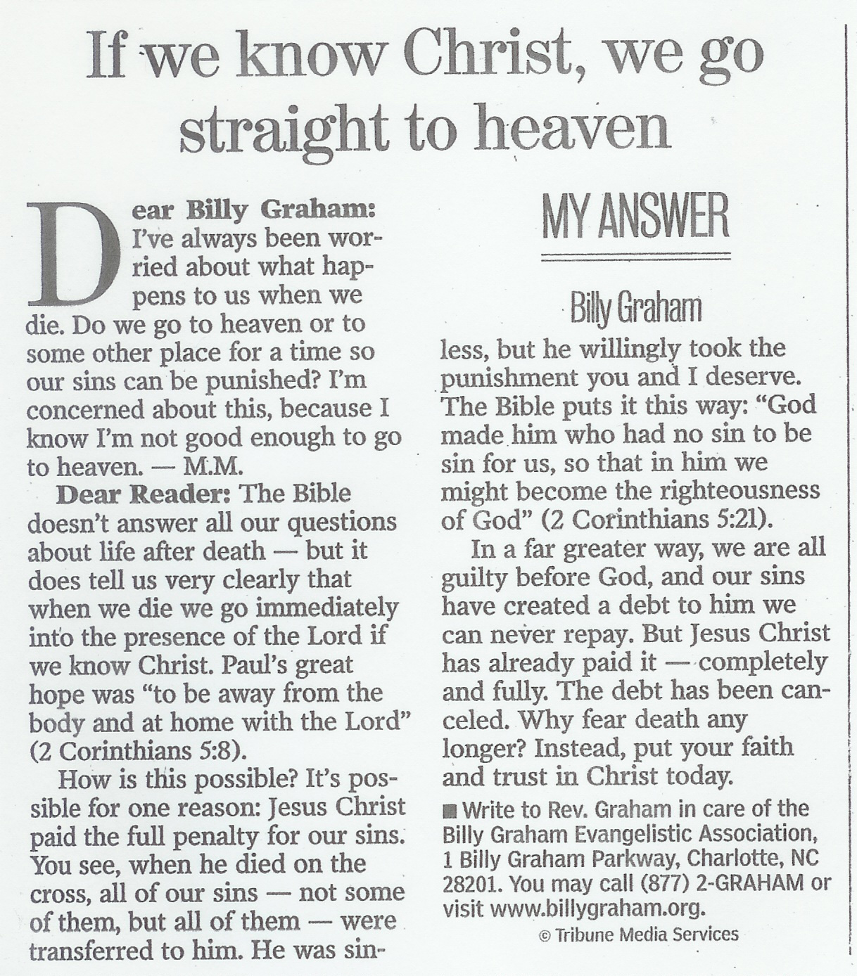
To KNOW Him is to love Him
To love Him is to Obey Him
John 14:15; Hebrews 5:9

Slide 4
The Teaching of God
Attitude of the Church Toward
Doctrines and Commandments of Men
Prove all things by the Bible
1 Thessalonians 5:21-22
Hold to the faithful Word of God
Titus 1:9; 2:1
Mature unto righteousness
Ephesians 4:14

Slide 5
The Teaching of God
Attitude of the Church Toward
Doctrines and Commandments of Men
Learn what the truth is
1 John 4:1-6
Speak only the truth of God
Acts 4:19-20

Slide 6
The Teaching of God
Attitude of the Church Toward False Teachers
Cut off the occasion for deceitful workers
2 Corinthians 11:12-15
No fellowship toward those not walking in truth
2 Thessalonians 3:6, 14-15

Slide 7
The Teaching of God
Attitude of the Church Toward False Teachers
Mark those who cause division
Romans 16:17-18
Not to receive false teachers
2 John 7-11

Slide 8
The Teaching of God
The Problem of Allowing
False Doctrines to be Taught
A little leaven, leavens the whole lump
Galatians 5:9
Jesus’ warning:
Revelation 2:14-16
Elders are responsible for protecting the church
Acts 20:27-32

Slide 9
The Teaching of God
May we learn from the early New Testament church to continue ONLY in the Apostle’s Doctrine
"test the spirits"
To ensure that everything that we do is approved of by God
1 John 4:1; Matthew 7:21

