Slide 1
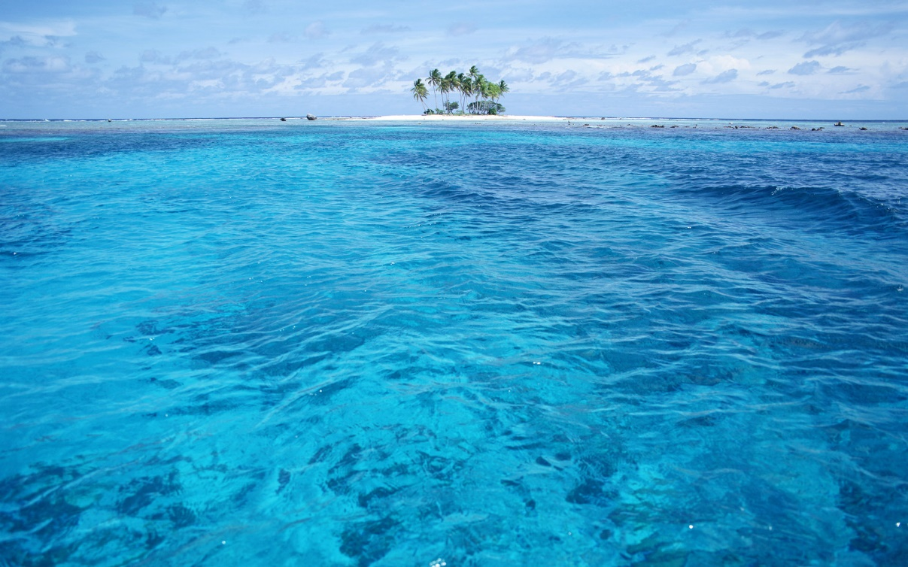
There was no more sea
Revelation 21:1-8

Slide 2
No sea of separation
The sea is a divider
Revelation 1:9
Today – things stand between man and man
In the future – nothing to separate brother from brother
Revelation 3:12
Revelation 21:3

Slide 3
No sea of painful mystery
The sea held mystery
Today – life holds many mysteries
Deuteronomy 29:29
1 Corinthians 2:9
In the spiritual world, the haze of life’s mystery will be cleared away
1 Corinthians 13:12
1 John 3:2

Slide 4
No sea of unrest
The sea is forever in motion
In the present world – nothing is ever the same
Revelation 13:1
Isaiah 57:20-21
Hebrews 13:14
In heaven – there will be no unrest
Hebrews 4:9; Revelation 14:13; Job 3:17

Slide 5
No sea of danger and death
The sea held fear for ancient people
Revelation 20:12-15
In life – some seek to submerge us
1 Timothy 1:18-20
In the spirit world – the sea of danger and death are unknown
Matthew 6:19-21
Revelation 21:4

Slide 6
conclusion
We are ALL heading for an end
Must live in a way where there is:
No sea of separation
No sea of painful mystery
No sea of unrest
No sea of danger and death
May we look forward to the day where we will always be together in an eternal heaven where there will be constant rest!

