Slide 1
The Thief on the Cross
Mark 16:16
Acts 2:38
Acts 22:16
1 Peter 3:21
Richie Thetford www.thetfordcountry.com

Slide 2
At Calvary
Two thieves were crucified with Christ
One asked Jesus to remember him in His kingdom
Acts 1:6
Jesus said:
What did Jesus mean?
Both Jesus and the thief would be in paradise – departed spirits
John 20:17
“….Assuredly, I say to you, today you will be with Me in Paradise.” Luke 23:43
Richie Thetford www.thetfordcountry.com

Slide 3
Was the Thief Saved?
“Paradise” suggests approval
Jesus’ story of the rich man and Lazarus
Luke 16:19-31
Could be assumed that the thief was saved
We should base our hope for eternity upon the Bible and the will of Christ
Richie Thetford www.thetfordcountry.com

Slide 4
Salvation
Assuming that the thief was saved – we cannot be saved the same way today
Christ personally forgave sins
Luke 5:17-20
Luke 7:36-50
Jesus personally forgave their sins
Richie Thetford www.thetfordcountry.com

Slide 5
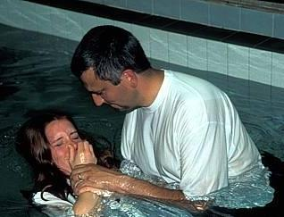
This Side of the Cross
We live under a different covenant today
Hebrews 9:15-17
We live after the death of the Testator
One now needs to be baptized
Matthew 10:32
Mark 16:16
1 Peter 3:21
Richie Thetford www.thetfordcountry.com

Slide 6
Salvation in Christ
We are baptized into the body of Christ
1 Corinthians 12:13
Christ is the savior of the body
Ephesians 5:23
No promise of salvation for those outside the body of Christ
Baptism required in all cases in the New Testament
Acts 2:38; 8:12-18; 10:47-48; 16:15; 16:33; 18:8; 19:3-5; 22:16
Richie Thetford www.thetfordcountry.com

Slide 7
Heaven is too wonderful and Hell too terrible for us to risk being misled by erroneous beliefs concerning the thief on the cross
Richie Thetford www.thetfordcountry.com

