Slide 1
Matthew 23:23
Matthew 5:20
Richie Thetford www.thetfordcountry.com

Slide 2
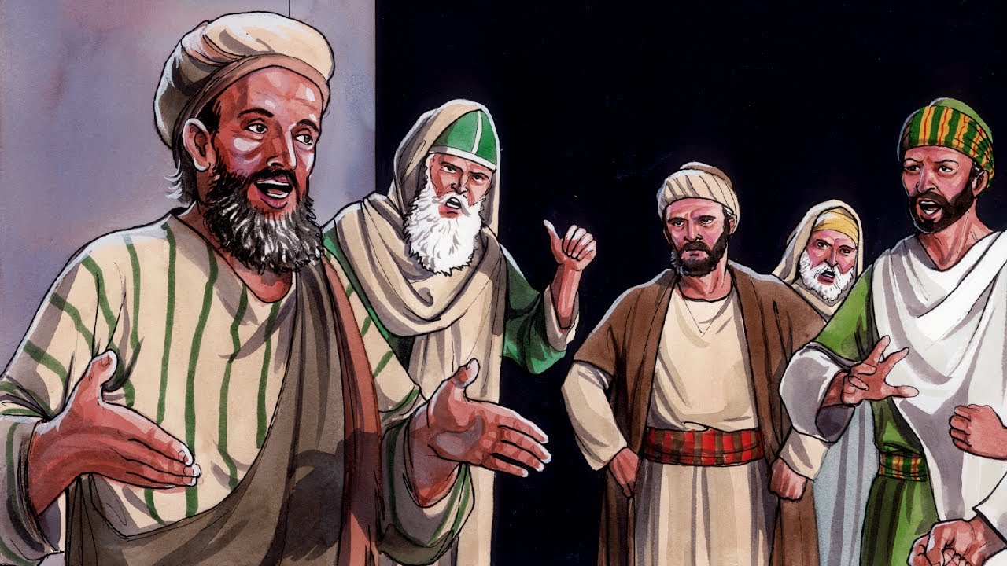
Who Are These Pharisees?
Associated themselves with the “Law” – to observe strictly
Had the greatest influence upon the congregations
Their teachings:
Every soul is imperishable
The existence of Angels and spirits
Acts 23:8
All depends on fate and God
Looked at politics from a religious view
Richie Thetford www.thetfordcountry.com

Slide 3
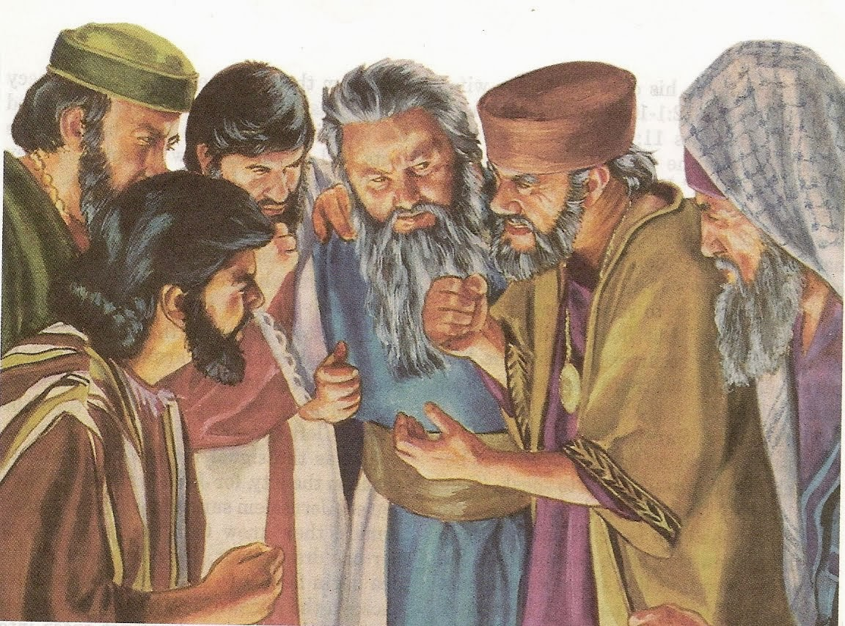
Who Are These Pharisees?
Their practices:
Avoided non-Pharisees because they were considered “unclean”
Mark 2:14-17
Richie Thetford www.thetfordcountry.com

Slide 4
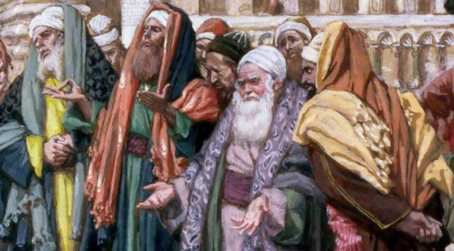
Who Are These Pharisees?
According to history – Seven different kinds of Pharisees:
Shechemite Pharisee
Tumbling Pharisee
Bleeding Pharisee
Mortar Pharisee
What-am-I-yet-to-do Pharisee
Pharisee from fear
Pharisee from love
Richie Thetford www.thetfordcountry.com

Slide 5
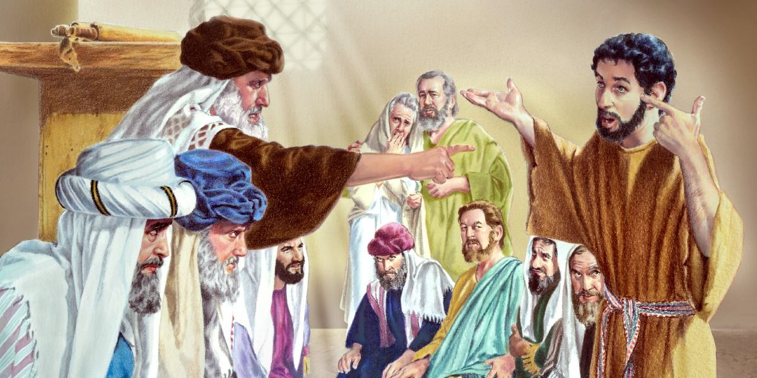
Comparing Pharisaism and Christianity
Pharisee was focused on keeping every letter of the law – something greater was overlooked
Matthew 5:17, 21-22
Jesus’ aim was to call men to the law of God
Matthew 12:1-13
Mark 7:2-4
Richie Thetford www.thetfordcountry.com

Slide 6
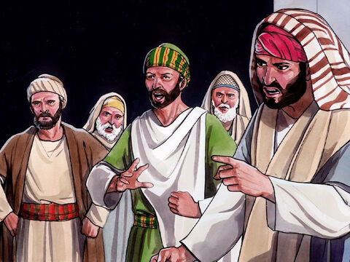
Comparing Pharisaism and Christianity
Jesus’ aim was to teach men that true piety consisted not in forms, but in substance
Luke 11:42
Religion should be in man’s heart
Luke 11:37-41
Matthew 19:3
Matthew 19:7-8
Richie Thetford www.thetfordcountry.com

Slide 7
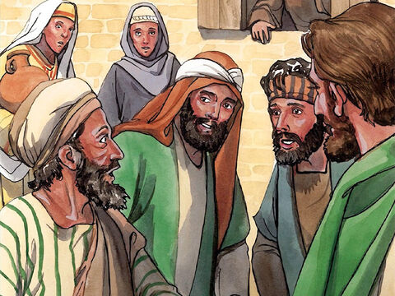
Comparing Pharisaism and Christianity
Pharisees sought mainly to attract attention and admiration of men
Matthew 6:2; 6:16; 23:5-6
Pharisees regarded degraded classes to be shunned
Luke 7:39; 15:2
Pharisees devoted energies to making converts to their narrow views
Matthew 23:15
Richie Thetford www.thetfordcountry.com

Slide 8
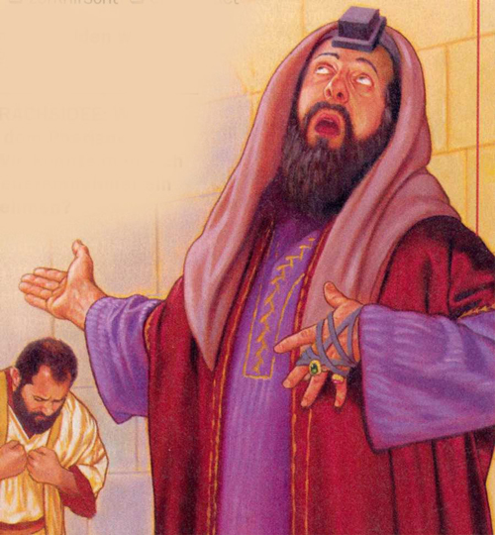
Conclusion
Jesus did not think much of these kind of Pharisees
Our righteousness must exceed that of the Pharisees
Matthew 5:20
Romans 6:17; 10:9-10
Matthew 5:6
Are we all keeping these “weightier matters” of the Word of God today?
Richie Thetford www.thetfordcountry.com

