Slide 1
What Is truth?
John 18:33-38
Richie Thetford www.thetfordcountry.com

Slide 2
Not Mental Adjustment
Truth must abide through knowledge
1 John 2:4
Proverbs 14:12
Jeremiah 10:23
Mark 7:6-8
2 Timothy 4:3-4
Richie Thetford www.thetfordcountry.com

Slide 3
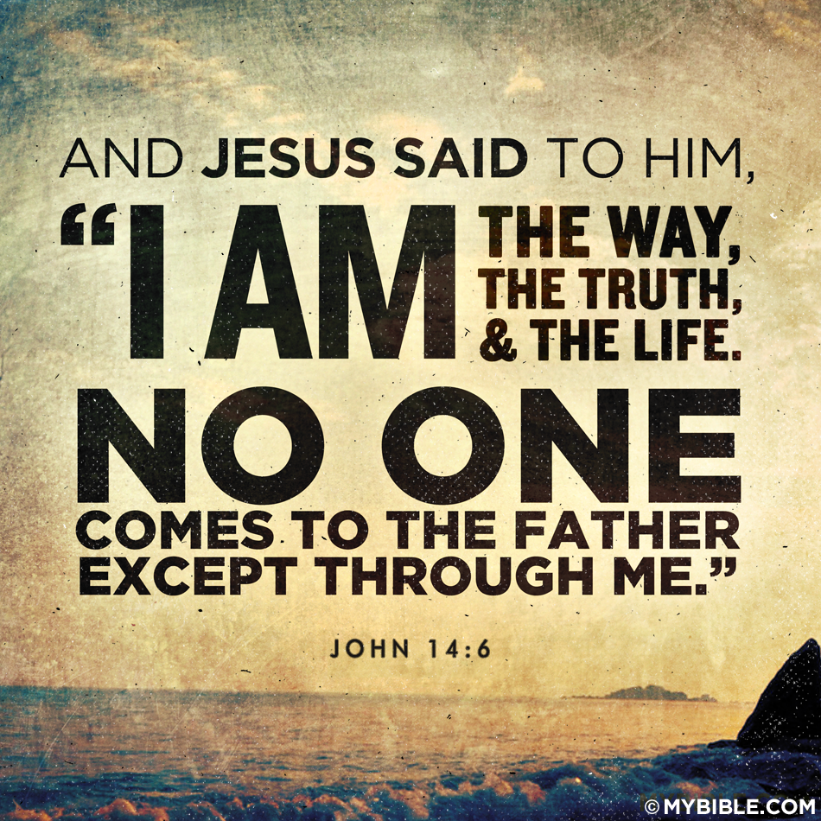
I Am the Truth
Jesus is the only way to salvation
John 14:6
John 1:14
John 1:17
Hebrews 6:18
1 John 5:7
John 16:13
John 8:45-47
John 18:36-37
Richie Thetford www.thetfordcountry.com

Slide 4
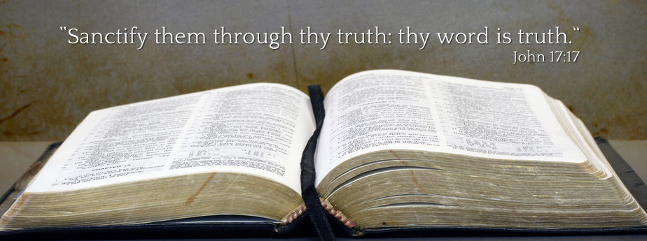
Your Word is Truth
Must listen to God’s Word
John 17:17
Psalms 119:142, 151
Isaiah 25:1
Daniel 4:27
Romans 1:24-25
Richie Thetford www.thetfordcountry.com

Slide 5
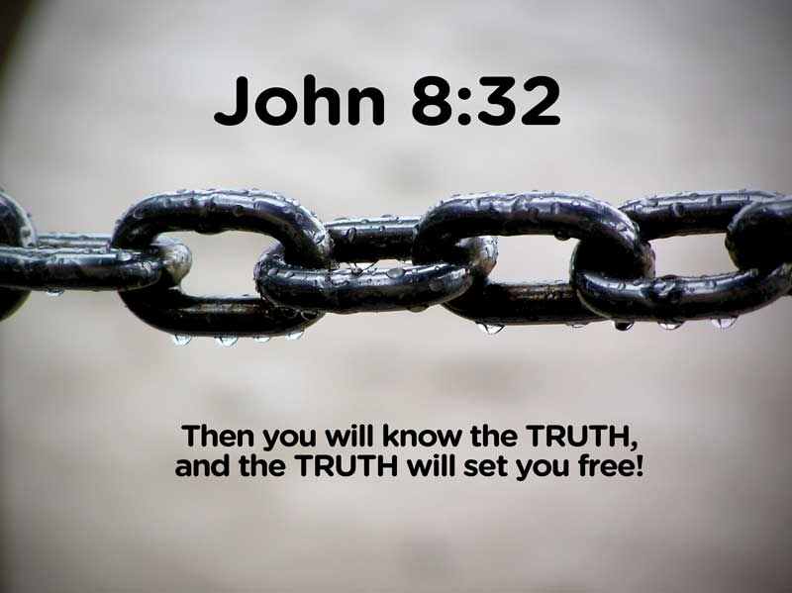
Church is the Pillar of Truth
Must present the truth
1 Timothy 3:15
Truth Shall Make You Free
Can only be made free with the truth
John 8:32
Joshua 24:14
2 Thessalonians 2:10
2 Timothy 2:25-26
Richie Thetford www.thetfordcountry.com

Slide 6
Conclusion
Do you KNOW the truth?
Have you obeyed the truth?
Romans 1:18
2 Thessalonians 2:12
“Have I therefore become your enemy because I tell you the truth?
Galatians 4:16
Richie Thetford www.thetfordcountry.com

