Slide 1
Wine
Richie Thetford www.thetfordcountry.com

Slide 2
Introduction
What God says:
Proverbs 20:1
Proverbs 23:29-35
1 Peter 4:3
Traditions or Doctrine?
Matthew 15:8-9
Acts 4:18-20
1 Peter 2:21-22
Colossians 3:17
Richie Thetford www.thetfordcountry.com

Slide 3
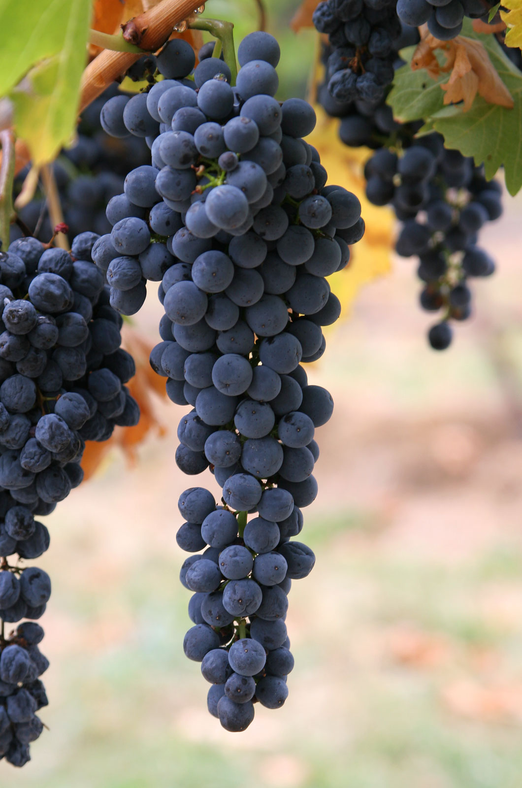
Does Bible “wine” mean “alcoholic wine?”
“Wine” is a generic term
“the fruit of the grape”
Could be fermented or unfermented
Context of the Bible passage shows us how God intends for it to be used
Richie Thetford www.thetfordcountry.com

Slide 4
Does Bible “wine” mean “alcoholic wine?”
Generic Term | Items
Groceries | Bread, eggs, milk, sugar, flour, salt Soap, batteries, pens, paper
Automobile | Manufacturer Model, kind, size, color, interior
Furniture | Chair, couch Television, bookshelf, piano
Music | Vocal, instrumental, or both Rock, country, religious
Wine | Fermented, unfermented
Richie Thetford www.thetfordcountry.com

Slide 5
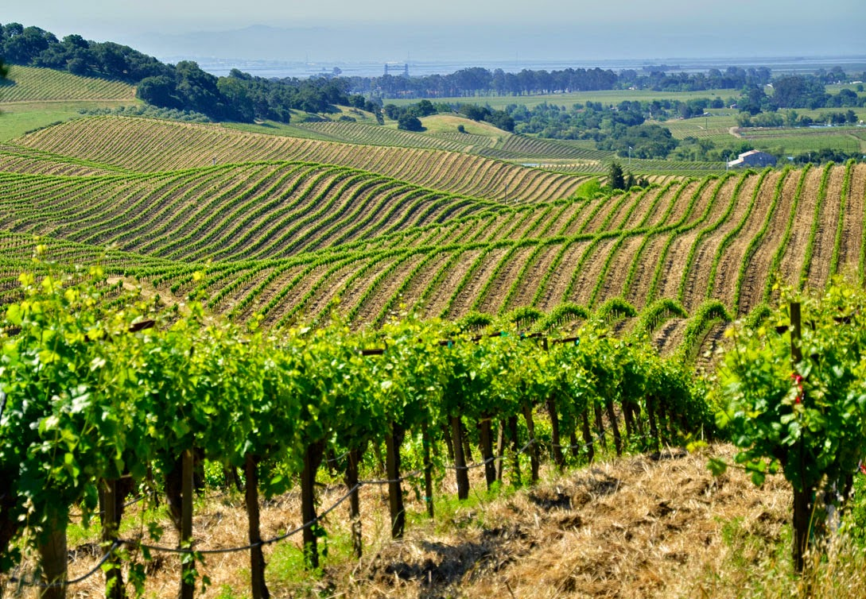
Does Bible “wine” mean “alcoholic wine?”
Other examples of “wine”
John 19:29-30
Isaiah 27:2
Nehemiah 5:18
A mistake to assume that the word “wine” refers to an alcoholic drink unless context shows that it does
Richie Thetford www.thetfordcountry.com

Slide 6
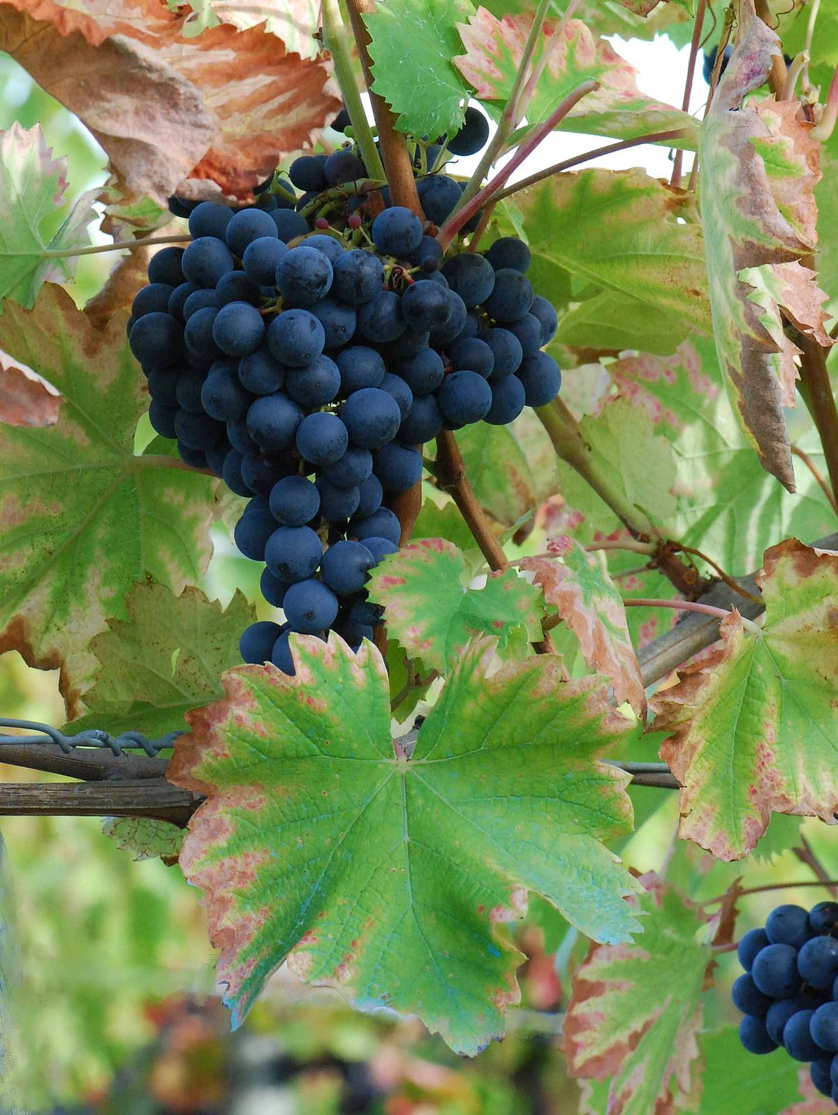
Apples to Apples
Are those who justify social drinking actually drinking “wine” or “strong drink?”
Fermented wine in ancient Palestine contained not over 5 to 8 percent alcohol
In our society brandy, rum, whisky and gin contain 50% or more alcohol
Modern-day alcoholic drinks cannot be compared to the fermented wine in Bible times
Richie Thetford www.thetfordcountry.com

Slide 7
Apples to Apples
Alcoholic Content in Most Modern-Day Wines
Wine | Content
Wine Coolers | 4-7%
Table Wine (general) | 8-14%
White, dry | 11%
White, sparkling | 12%
White, sweet | 12.4%
Cabernet | 11-14%
Dessert Wine | 14-20%
Zinfandels | 17-22%
Vermouth | 17-22%
Port Wine | 20%
Richie Thetford www.thetfordcountry.com

Slide 8
Strong Drink
Don’t confuse “wine” with “strong drink”
God considers wine and strong drink distinct from one another
“Strong drink” – intoxicating beverage
Leviticus 10:9
1 Samuel 1:15
Proverbs 20:1
Luke 1:15
Would a true Christian be in favor of partaking in something God condemns?
Richie Thetford www.thetfordcountry.com

Slide 9
“Woe to those who call evil good, and good evil; Who put darkness for light, and light for darkness; Who put bitter for sweet, and sweet for bitter!”
Isaiah 5:20
Richie Thetford www.thetfordcountry.com

