Slide 1
Workers for the lord
2 Timothy 2:15
1 Corinthians 15:58
Richie Thetford www.thetfordcountry.com

Slide 2
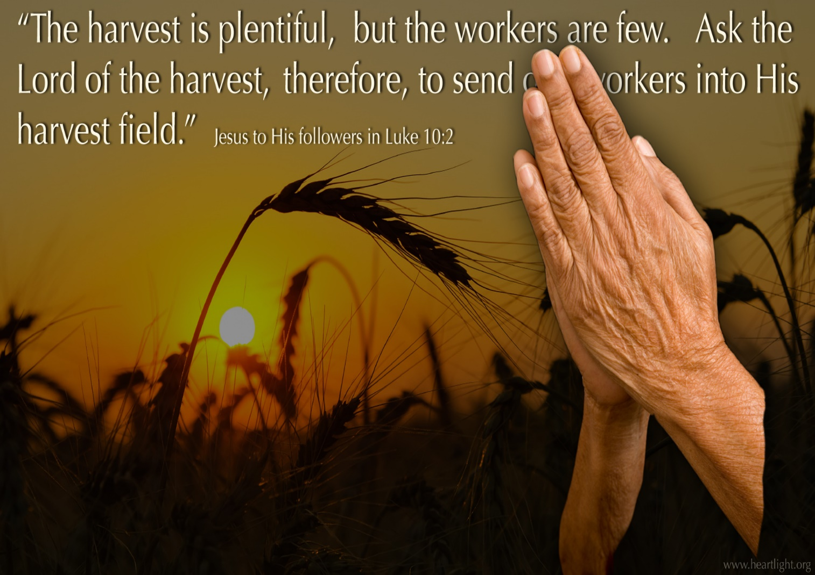
The greatest work we can do
Matthew 4:18-22
Luke 9:57-62
Philippians 2:29-30
1 Corinthians 16:15
1 Corinthians 15:10
1 Timothy 1:12
Richie Thetford www.thetfordcountry.com

Slide 3
Problems why our work is hindered
Ecclesiastes 11:4
Galatians 6:4
2 Timothy 2:15
Galatians 6:9
Hebrews 6:11-12
Richie Thetford www.thetfordcountry.com

Slide 4
The Lord will make workers of us
2 Timothy 2:21
Ephesians 2:10
Philippians 2:13
Hebrews 13:20-21
1 Peter 4:11
John 4:34
2 Corinthians 12:15
2 Timothy 2:15
2 Timothy 3:16-17
1 Timothy 4:15-16
Richie Thetford www.thetfordcountry.com

Slide 5
conclusion
The Lord needs everyone to be workers
Matthew 9:37-38
John 9:4
No joy compares to being a worker for the Lord
1 Thessalonians 2:8
1 Thessalonians 2:19-20
Luke 12:43
Richie Thetford www.thetfordcountry.com

