Slide 1


YOUR
PROGRESS
May Be Evident to All
1 Timothy 4:12-16
Richard Thetford www.thetfordcountry.com

Slide 2

YOUR PROGRESS
May Be Evident to All
Character
“a distinctive mark;
a distinctive trait or quality;
one’s pattern of behavior or personality”
Character is what we are
Richard Thetford www.thetfordcountry.com

Slide 3

YOUR PROGRESS
May Be Evident to All
WHAT SHOULD WE BE?
What makes up our character?
  Word, Conduct, Love, Spirit, Faith, Purity
WORD
  Conversation
    2 Timothy 1:13
    Ephesians 4:29
    Matthew 12:37
Richard Thetford www.thetfordcountry.com

Slide 4

YOUR PROGRESS
May Be Evident to All
WHAT SHOULD WE BE?
What makes up our character?
  Word, Conduct, Love, Spirit, Faith, Purity
CONDUCT
  Manner of one’s life
    Ephesians 4:22
    1 Timothy 3:15
    2 Peter 3:11
    Philippians 1:27
Richard Thetford www.thetfordcountry.com

Slide 5

YOUR PROGRESS
May Be Evident to All
WHAT SHOULD WE BE?
What makes up our character?
  Word, Conduct, Love, Spirit, Faith, Purity
LOVE
  From a pure heart
    Romans 12:9-13
Richard Thetford www.thetfordcountry.com

Slide 6

YOUR PROGRESS
May Be Evident to All
WHAT SHOULD WE BE?
What makes up our character?
  Word, Conduct, Love, Spirit, Faith, Purity
SPIRIT
  A mild, meek, forgiving
  disposition
    Matthew 5:3
    Ephesians 4:32
Richard Thetford www.thetfordcountry.com

Slide 7

YOUR PROGRESS
May Be Evident to All
WHAT SHOULD WE BE?
What makes up our character?
  Word, Conduct, Love, Spirit, Faith, Purity
FAITH
  Devotion to duty,
  obligations, or vows
    Titus 2:10
    Hebrews 11:1
Richard Thetford www.thetfordcountry.com

Slide 8

YOUR PROGRESS
May Be Evident to All
WHAT SHOULD WE BE?
What makes up our character?
  Word, Conduct, Love, Spirit, Faith, Purity
PURITY
  Think about situations
  we find ourselves in
    1 John 3:2-4
Richard Thetford www.thetfordcountry.com

Slide 9

YOUR PROGRESS
May Be Evident to All
HOW TO PROGRESS IN OUR DEVELOPMENT
Things that make up our personality
  Attention to reading, exhortation, doctrine, meditation
ATTENTION TO READING
  Develops our character
  to be Christ-like
    2 Timothy 2:15
    Matthew 11:29
Richard Thetford www.thetfordcountry.com

Slide 10
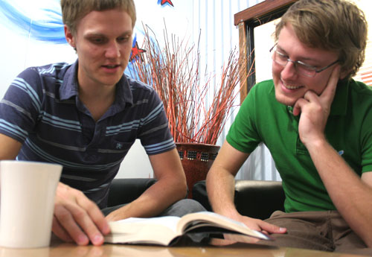
YOUR PROGRESS
May Be Evident to All
HOW TO PROGRESS IN OUR DEVELOPMENT
Things that make up our personality
  Attention to reading, exhortation, doctrine, meditation
EXHORTATION
  Practical duties
  of religion
    2 Timothy 4:8
    2 Thessalonians 1:8-9
Richard Thetford www.thetfordcountry.com

Slide 11

YOUR PROGRESS
May Be Evident to All
HOW TO PROGRESS IN OUR DEVELOPMENT
Things that make up our personality
  Attention to reading, exhortation, doctrine, meditation
DOCTRINE
  Principles set forth
  by Jesus Christ
    Romans 6:17
    1 Timothy 4:6
Richard Thetford www.thetfordcountry.com

Slide 12

YOUR PROGRESS
May Be Evident to All
HOW TO PROGRESS IN OUR DEVELOPMENT
Things that make up our personality
  Attention to reading, exhortation, doctrine, meditation
MEDITATION
  Mind deeply impressed
  with God’s law
    Psalms 1:2
    Philippians 4:8
Richard Thetford www.thetfordcountry.com

Slide 13

YOUR PROGRESS
May Be Evident to All
THE IMPORTANCE OF PROGRESSING
Our progress will be evident to all!
  God will get the glory
    Matthew 5:16
    Philippians 2:15-16
  Others will know we
  are Christians!
    Philippians 1:25
Richard Thetford www.thetfordcountry.com

Slide 14

YOUR PROGRESS
May Be Evident to All
THE IMPORTANCE OF PROGRESSING
We “will save both ourselves and those who hear us”
  1 Corinthians 9:27
  Jeremiah 23:22
Only when we remain in God’s counsel and take the opportunity to teach others can we have an effect on their soul
Richard Thetford www.thetfordcountry.com

Slide 15

YOUR PROGRESS
“May Be Evident to All”
Be the right example in word, conduct,
love, spirit, faith and purity
Make daily progress by giving
attention to reading,
exhortation, and to
doctrine
Meditate on these things and give ourselves entirely to them!
Richard Thetford www.thetfordcountry.com

