Slide 1
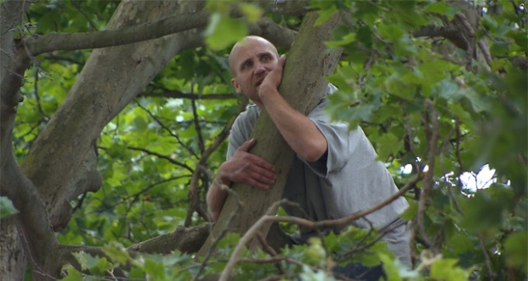
Zacchaeus
Luke 19:1-10
Richie Thetford www.thetfordcountry.com

Slide 2
His Need of Salvation
Sin is the common curse
Romans 3:23
Jude 3
The words of Christ
Luke 19:10
Richie Thetford www.thetfordcountry.com

Slide 3
Hindrances He Overcame
Wealth
Luke 18:24-26
1 Timothy 6:10
Occupation
Physical limitations
Richie Thetford www.thetfordcountry.com

Slide 4
Blessings He Received
Salvation
Fellowship with the Lord
1 Timothy 2:3-4
2 John 9-10
Richie Thetford www.thetfordcountry.com

Slide 5
The Response He Made
Giving
“Restore fourfold”
Numbers 5:7
Richie Thetford www.thetfordcountry.com

Slide 6
Conclusion
Publicans excommunicated
Matthew 18:17
Earnestness of spirit will prevail
Right Attitude
Luke 18:9-14
Eternity
Matthew 11:28-30
Richie Thetford www.thetfordcountry.com

