Slide 1

At the CROSS
Richard Thetford www.thetfordcountry.com

Slide 2
At the CROSS
Isaiah 53:4-5
Song: 157
“At the Cross”
Opening Prayer
Richard Thetford www.thetfordcountry.com

Slide 3

Christ Died for Sinners
Isaiah 59:1-2
Song: 340
“I Gave My Life for Thee”
James 1:13-15; 1 John 1:8-10
Song: 166
“He Loved Me So”
Richard Thetford www.thetfordcountry.com

Slide 4

The Blood of Christ Cleanses Us from Sin
Revelation 5:6-12
Song: 160
“One Day”
Hebrews 9:11-14
Song: 174
“Christ Arose”
Richard Thetford www.thetfordcountry.com

Slide 5

By God’s Grace, Jesus Died for Us
1 John 3:16; 4:8-10
Song: 8
“Glory to His Name”
Ephesians 2:4-10
Song: 420
“O Thou Fount of Every Blessing”
Richard Thetford www.thetfordcountry.com

Slide 6
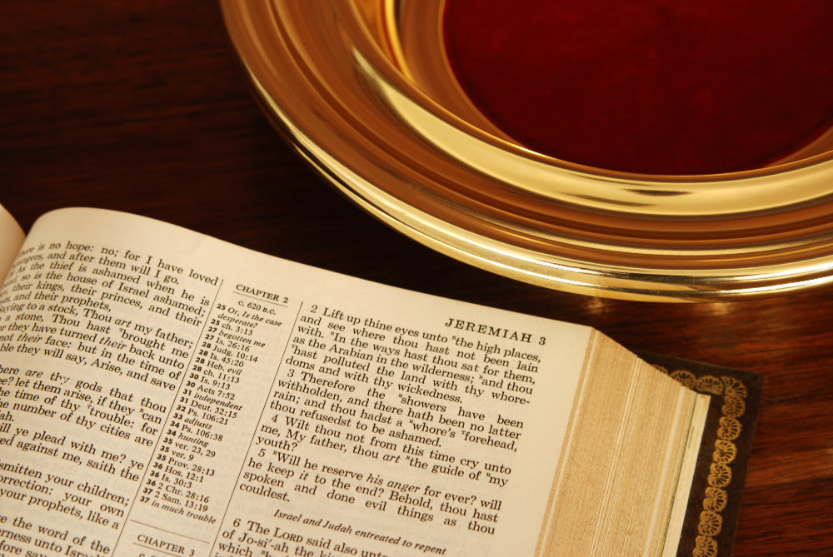
COLLECTION
Song # 128
“Take My Life, and Let it Be”
Richard Thetford www.thetfordcountry.com
Richard Thetford www.thetfordcountry.com

Slide 7
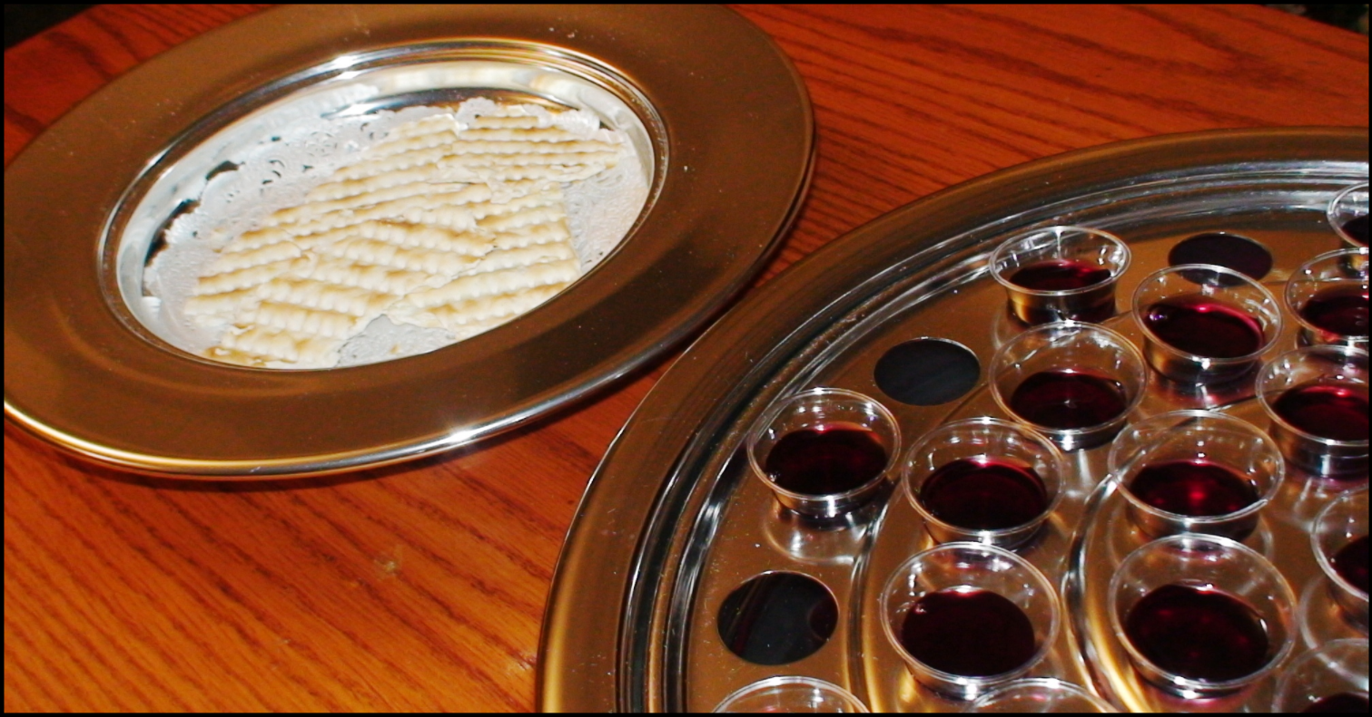
LORD’S SUPPER
Song # 159
“When My Love to Christ Grows Weak”
Galatians 3:10-14
Richard Thetford www.thetfordcountry.com

Slide 8

Jesus’ Death Demands Our Total Sacrifice
Romans 6:1-11
Song: 105
“I Am Thine, O Lord”
Galatians 2:19-21
Song: 97
“O To Be Like Thee”
Richard Thetford www.thetfordcountry.com

Slide 9

AT THE CROSS
INVITATION LESSON
Invitation Song: 276
“There Is Power in the Blood”
Closing Song: 493
“Heaven Came Down”
Closing Prayer
Richard Thetford www.thetfordcountry.com

Slide 10
At the CROSS
Richard Thetford www.thetfordcountry.com

