Slide 1
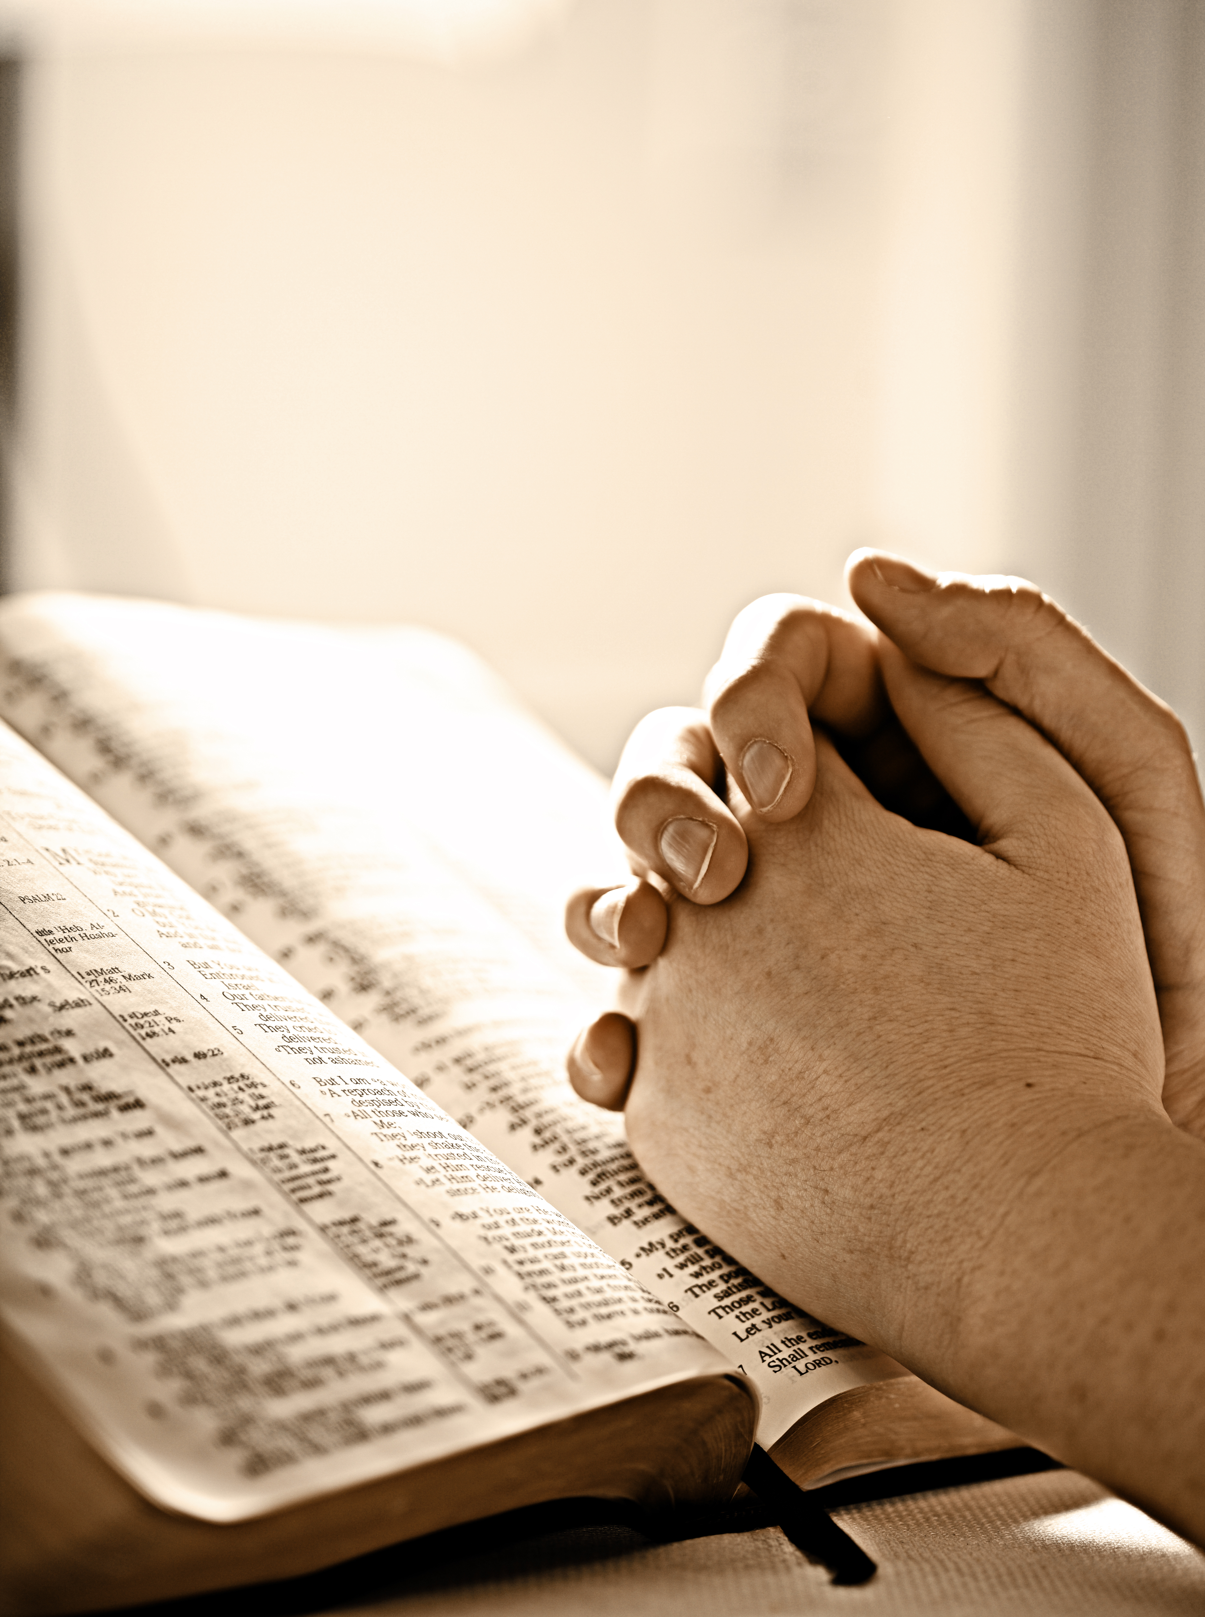
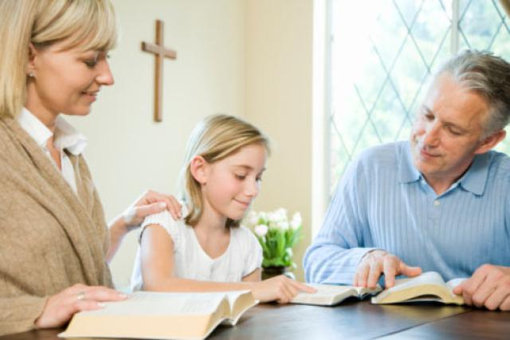
“I’m Happy Today”
1 Peter 1:3-9
Song #28
“Is It For Me?”
Opening Prayer
Richard Thetford www.thetfordcountry.com

Slide 2
I’m Happy Today
Song #251 “I’m Happy Today” (verse 1 only)
Psalm 30:1-12 Song #19 “Heavenly Sunlight”
John 15:5-11 Song #683 “Sing And Be Happy”
Richard Thetford www.thetfordcountry.com

Slide 3
I’m Singing Today
Song #251 “I’m Happy Today” (verse 2 only)
Psalm 96:1-13 Song #522 “When The Role Is Called Up Yonder”
Colossians 3:16; James 5:13 Song #208 “Sing To Me Of Heaven”
Richard Thetford www.thetfordcountry.com

Slide 4
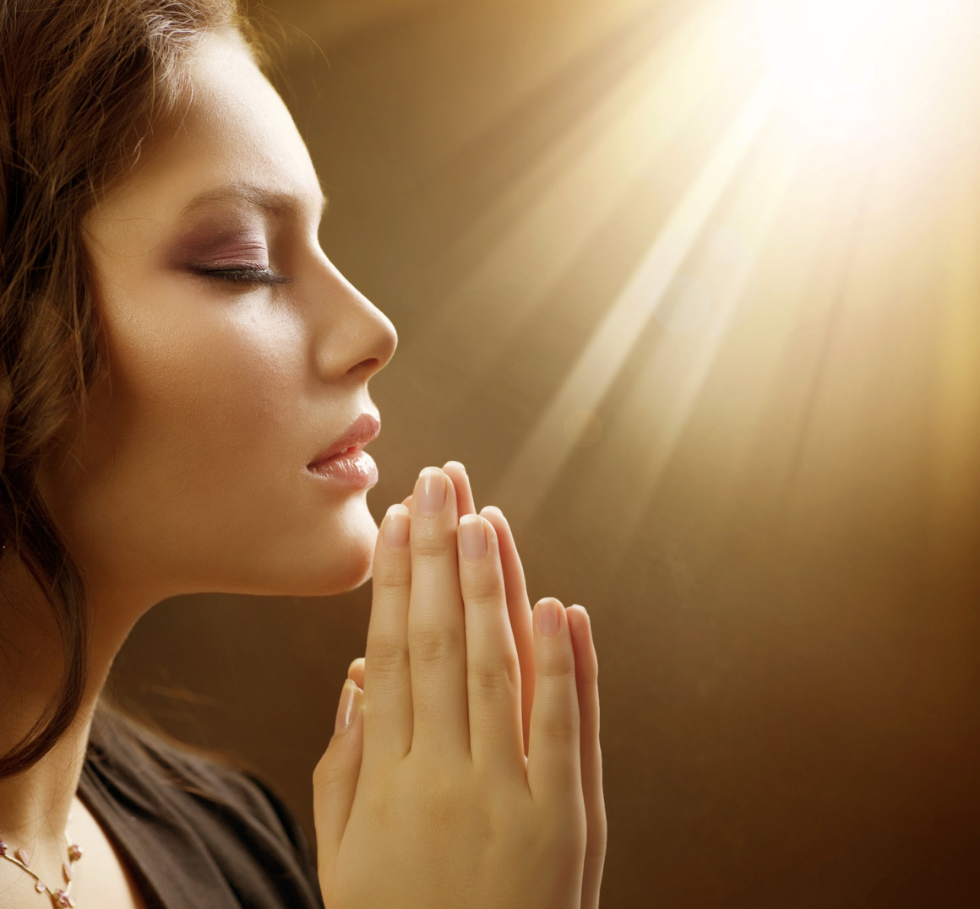
I’m Praying Today
Song #251 “I’m Happy Today” (verse 3 only)
Luke 17:11-19; Luke 18:1-8 Song #68 “Lord, We Come Before Thee Now”
Luke 22:14-22 Song #175 “The Breaking of Bread”
Lord’s Supper Offered
Richard Thetford www.thetfordcountry.com

Slide 5
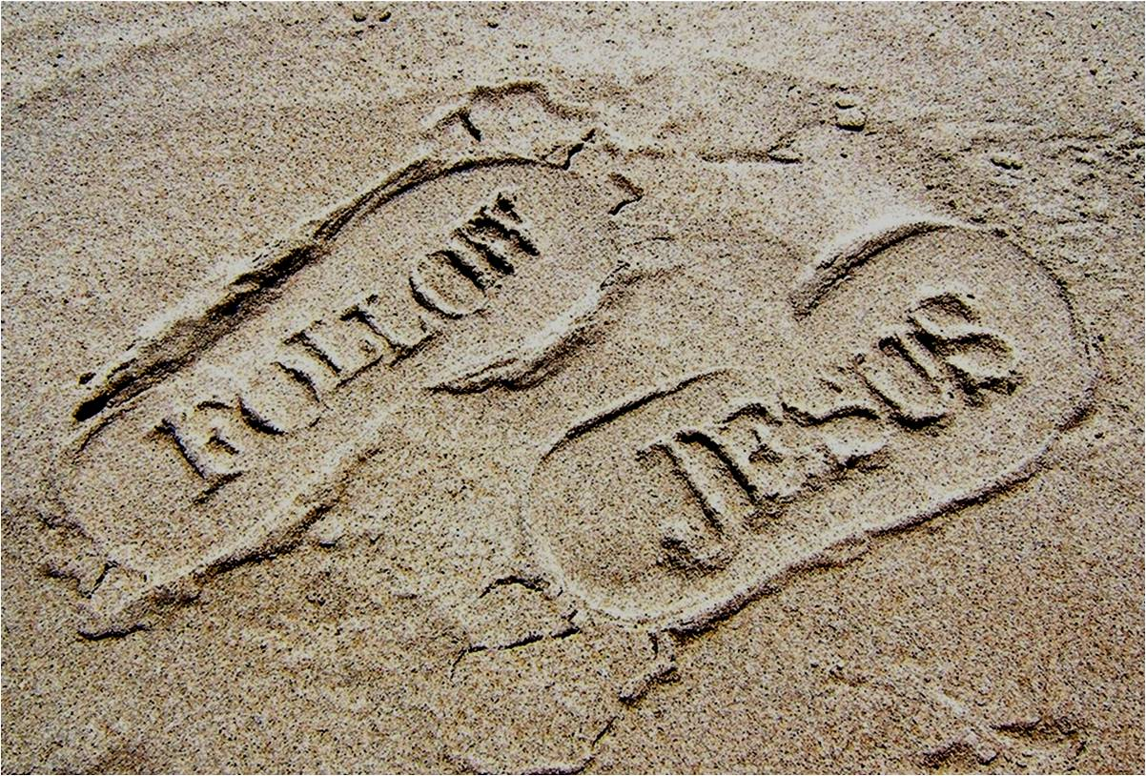
I’m Living Today
Song #251 “I’m Happy Today” (verse 4 only)
John 10:1-10 Song #391 “Savior, Like A Shepherd Lead Us”
Richard Thetford www.thetfordcountry.com

Slide 6
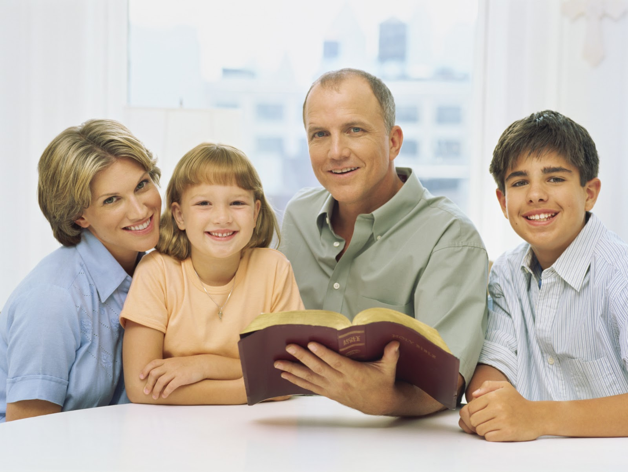
“I’m Happy Today”
Invitation Song #272 “Jesus the Loving Shepherd”
Closing Song #251 “I’m Happy Today” (verse 5 only)
Closing Prayer
Richard Thetford www.thetfordcountry.com

