Slide 2
1 John 4:15-21
Song #412
“God Is Love”
Opening Prayer

Slide 3
Seen in the Gift of His Son
1 John 4:7-12
Song #41
“Fairest Lord Jesus”

Slide 4
Seen in the Gift of His Son
John 3:11-21
Song #110
“My Jesus, I Love Thee”

Slide 5
God’s Love Seen in the Death of Christ
John 15:9-14
Song #608
“The Love of God”

Slide 6
God’s Love Seen in the Death of Christ
Romans 5:1-8
Song #164
“The Depth of God’s Love”

Slide 7
God’s Love Seen in Our New Relationship
1 John 3:1-18
Song #302
“Blest Be the Tie”

Slide 8
God’s Love Seen in Our New Relationship
Galatians 4:1-7
Song #180
“Wonderful Story of Love”

Slide 9
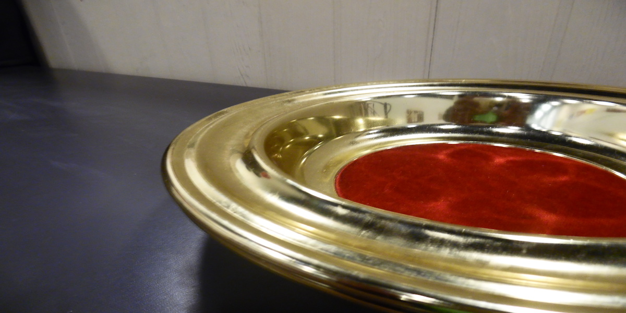
Collection
Song #392
“Count Your Blessings”

Slide 10
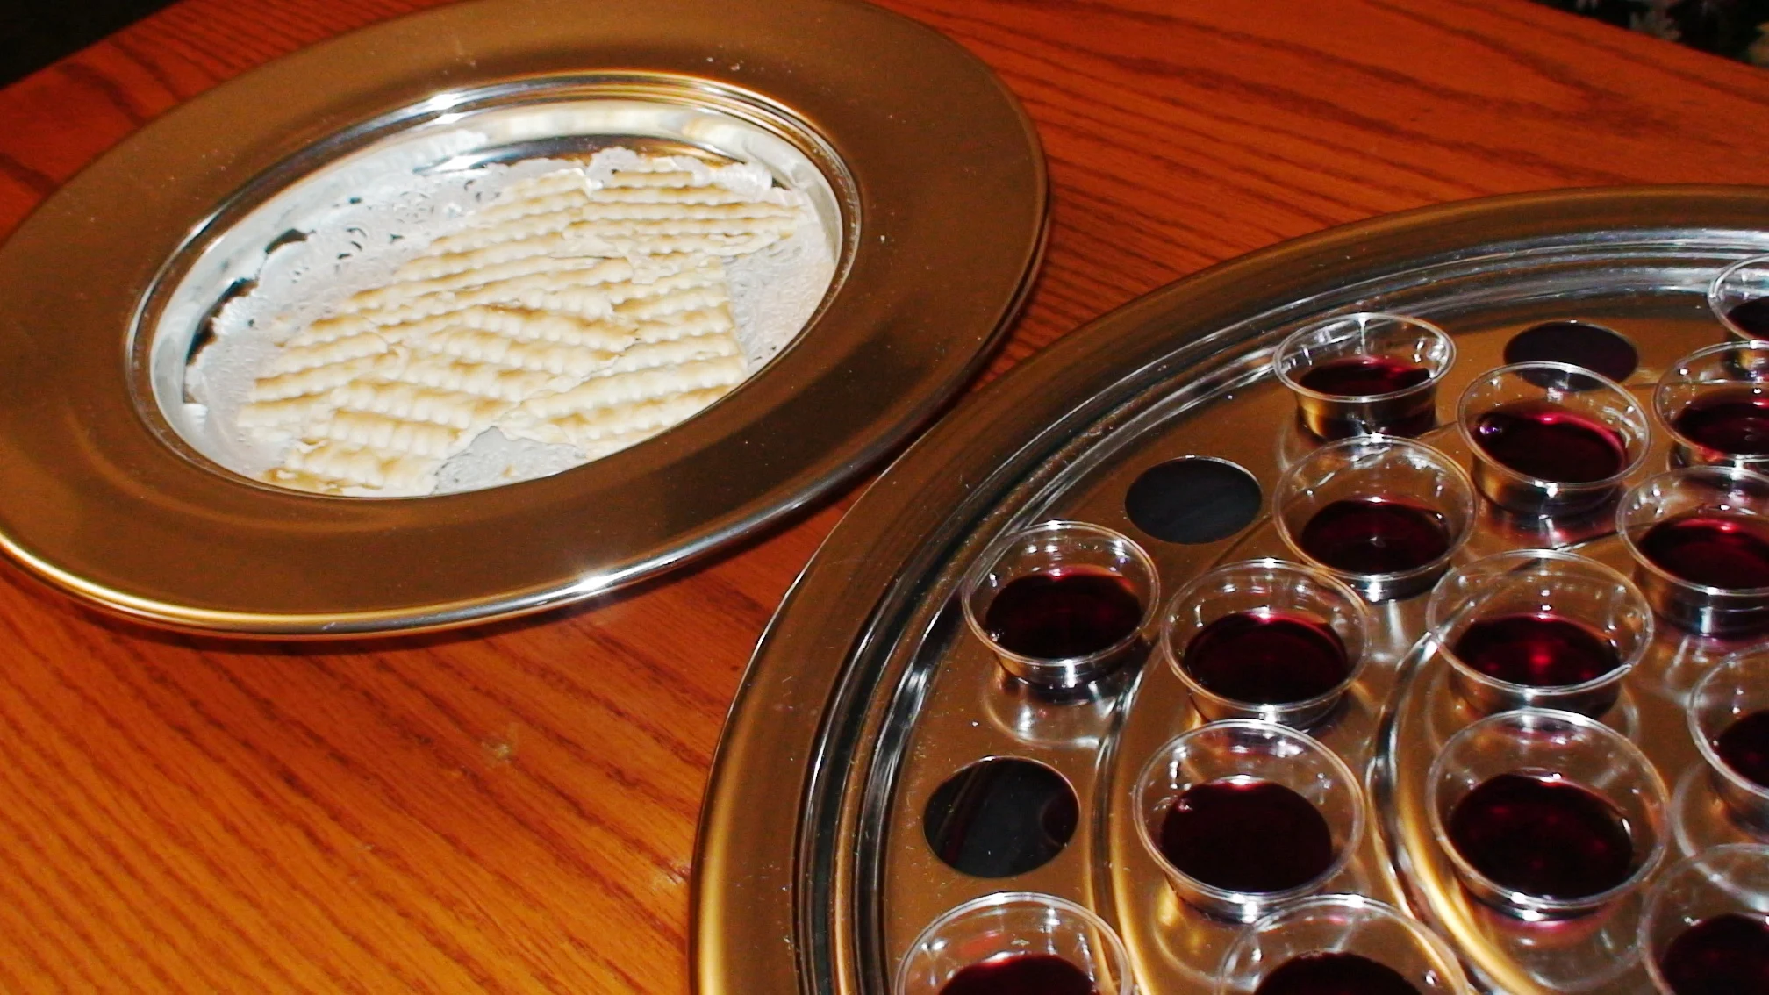
Lord’s Supper
Song #696
“He Loves Me”
John 13:18-27

Slide 11
God’s Love For Man is Seen in Our
John 14:15-24
Song #326
“Trust and Obey”

Slide 12
God’s Love For Man is Seen in Our
1 John 5:1-5
Song #489
“Blessed Are They”

Slide 13
Gospel INVITATION Offered
Invitation Song #272
“Jesus the Loving Shepherd”
Closing Prayer

