Slide 1
Take Time to be Holy

Slide 2
Take Time to be Holy
1 Peter 1:13-17
Song #1: “Holy, Holy, Holy”
Opening Prayer

Slide 3
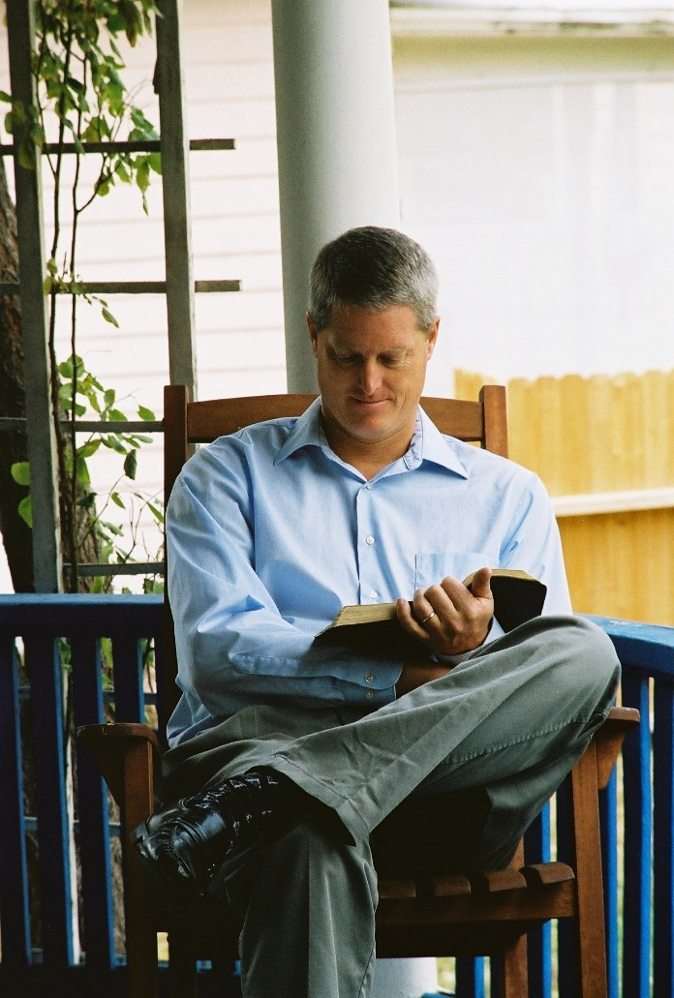
To Be Holy, We Must Use Our Time Properly
1 Peter 4:1-7 Song # 118: “Take Time to Be Holy” (V.1 only)
In Prayer: 1 Peter 1:13-17
Song #263: “Is Thy Heart Right with God?”
In Study: John 15:1-11
Song #119: “Only in Thee”
Care for Others: 1 Pet 4:8-9; John 15:12-17
Song #150: “Purer in Heart, O God”

Slide 4
This World Is Not Our Home
John 15:18-20 Song # 118: “Take Time to Be Holy” (V.2 only)
We Will Be Like Him: 1 Corinthians 15:34-54; 1 John 3:1-3
Song #307: “Are You Washed in the Blood?”
Actions Speak for Us: 1 Peter 1:13-15; 3:8-12
Song #489: “Blessed Are They”

Slide 5
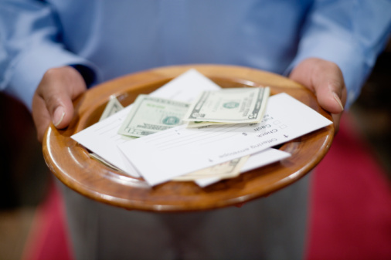
COLLECTION
Song #392: “Count Your Blessings”

Slide 6
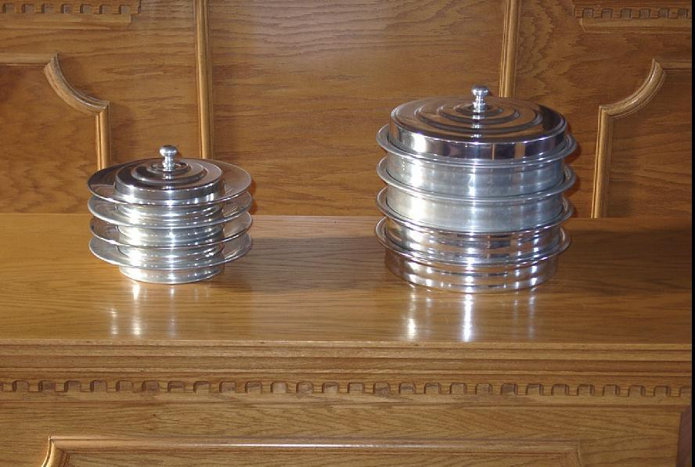
LORD’S SUPPER OFFERED
Song #179: “Lead Me to Calvary”
1 Corinthians 11:23-29

Slide 7
Be Calm In Thy Soul
Colossians 3:12-15 Song # 118: “Take Time to Be Holy” (V.3 only)
God Controls All: Matt 6:25-33; 1 Pet 5:6-7
Song #626: “It Is Well with My Soul”
Led By the Spirit: 1 Corinthians 2:1-16
Song #321: “Jesus I Come”
Fitted for His Service: Hebrews 13:15-21
Song #146: “Have Thine Own Way Lord”

Slide 8
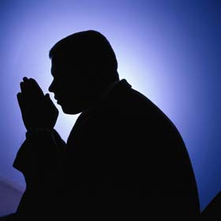
INVITATION
Invitation Song #311: “Why Not Now?”
Closing Prayer

