Slide 1
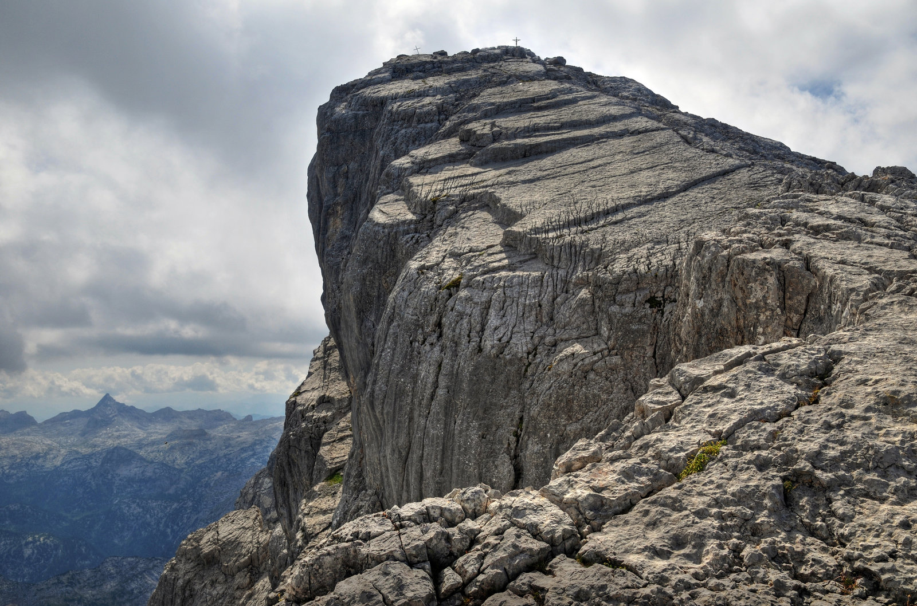
The Solid Rock
Richie Thetford www.thetfordcountry.com

Slide 2
THE SOLID ROCK
Introduction
1 Corinthians 10:1-4 Song #363: “He Hideth My Soul” Opening Prayer
Richie Thetford www.thetfordcountry.com

Slide 3
THE SOLID ROCK
My Hope Is Built on Nothing Less
Song #378: The Solid Rock (1st Verse Only) Matthew 7:21-28 Song #188: “There Stands A Rock” Acts 4:1-12 Song #109: “Higher Ground”
Richie Thetford www.thetfordcountry.com

Slide 4
THE SOLID ROCK
I Rest On His Unchanging Grace
Song #378: The Solid Rock (2nd Verse Only) Titus 2:11-14 Song #420: “O Thou Fount Of Every Blessing” Romans 5:6-8; Philippians 2:5-11; Mark 16:15-16 Song #164: “The Depth Of God’s Love”
Richie Thetford www.thetfordcountry.com

Slide 5
THE SOLID ROCK
His Oath, His Covenant, His Blood
Song #378: The Solid Rock (3rd Verse Only) Hebrews 6:13-20 Song #496: “We Have An Anchor”
Hebrews 8:1-13 Song #360: “Standing On The Promises”
Hebrews 10:1-10 Song #269: “Nothing But The Blood”
Richie Thetford www.thetfordcountry.com

Slide 6
THE SOLID ROCK
Lord’s Supper
John 19:1-18 Song #158: “Nailed To The Cross”
1 Corinthians 11:23-29
Richie Thetford www.thetfordcountry.com

Slide 7
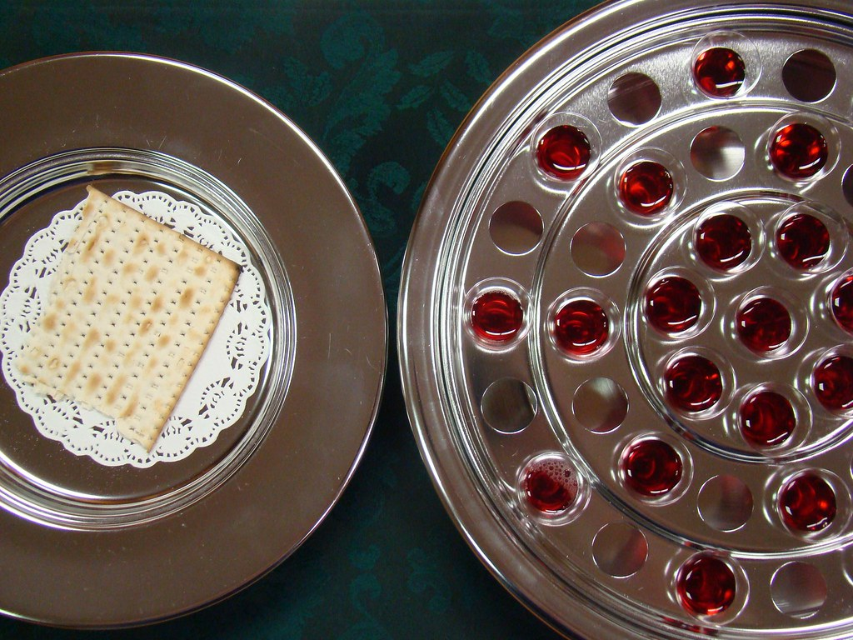
Lord’s Supper

Slide 8
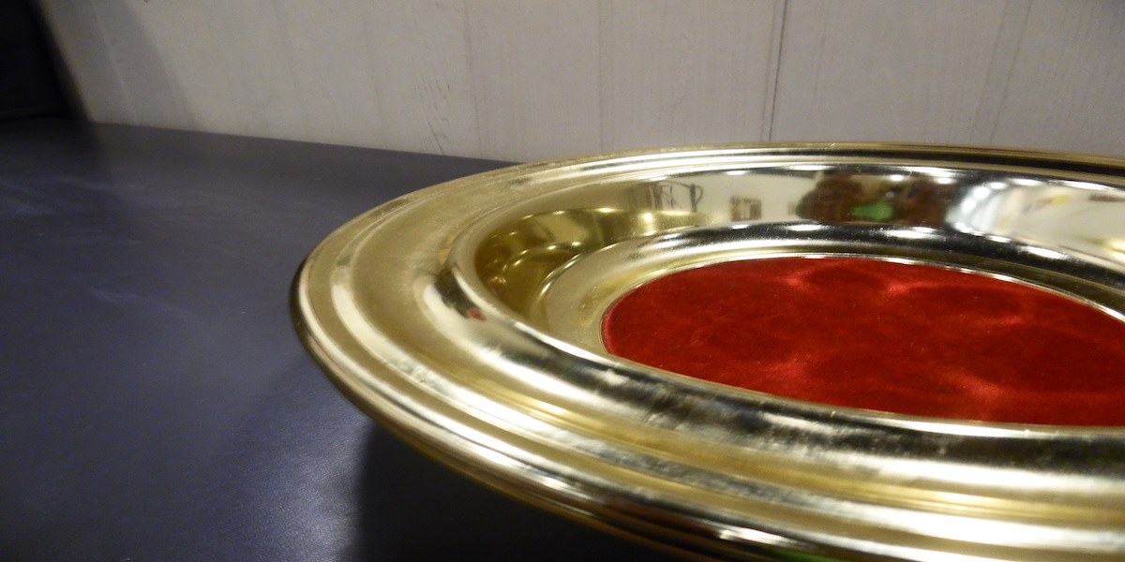
Collection

Slide 9
THE SOLID ROCK
Faultless to Stand Before His Throne
Song #378: The Solid Rock (4th Verse Only) Revelation 20:1-15 Song #68: “Lord, We Come Before Thee Now”
Richie Thetford www.thetfordcountry.com

Slide 10
THE SOLID ROCK
INVITATION
Invitation Song #284: “What Will Your Answer Be?”
Closing Song #194: “When We All Get To Heaven”
Closing Prayer
Richie Thetford www.thetfordcountry.com

