Slide 1
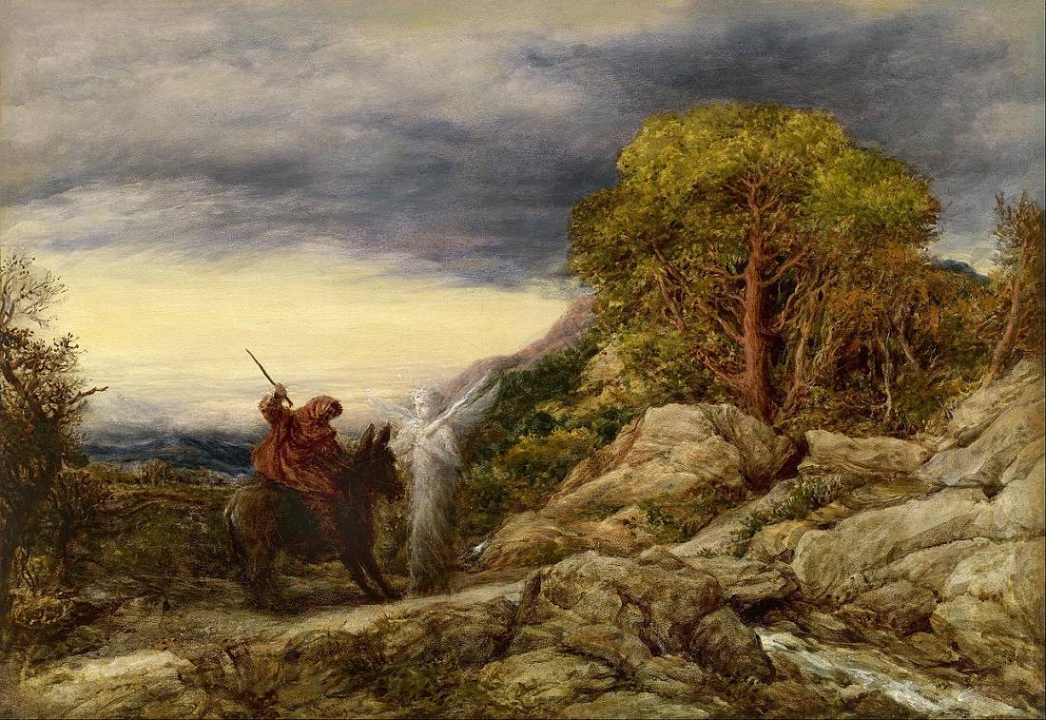
The Balaam’s Among Us
Numbers 22:1-21
Richie Thetford www.thetfordcountry.com

Slide 2
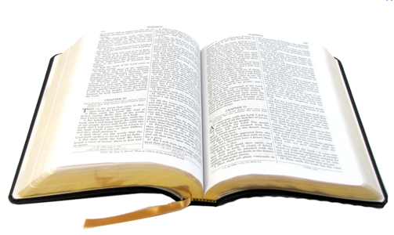
There Are Many Followers of God Like Balaam
Know what God says
  But think that God won’t mind if they do something differently
  BAPTISM
    Matthew 7:21
    Proverbs 14:12
    2 John 9
    Acts 2:38
    Acts 22:16
    1 Peter 3:21
Richie Thetford www.thetfordcountry.com

Slide 3
There Are Many Followers of God Like Balaam
Know what God says
  But think that God won’t mind if they do something differently
  DIVORCE AND REMARRIAGE
    1 Peter 1:24-25
    Matthew 19:9
    1 Corinthians 7:15
Richie Thetford www.thetfordcountry.com

Slide 4
There Are Many Followers of God Like Balaam
Know what God says
  But think that God won’t mind if they do something differently
  IMMODEST CLOTHING
    1 Timothy 2:9-10
    Matthew 18:7-8
    Mark 12:30
Richie Thetford www.thetfordcountry.com

Slide 5
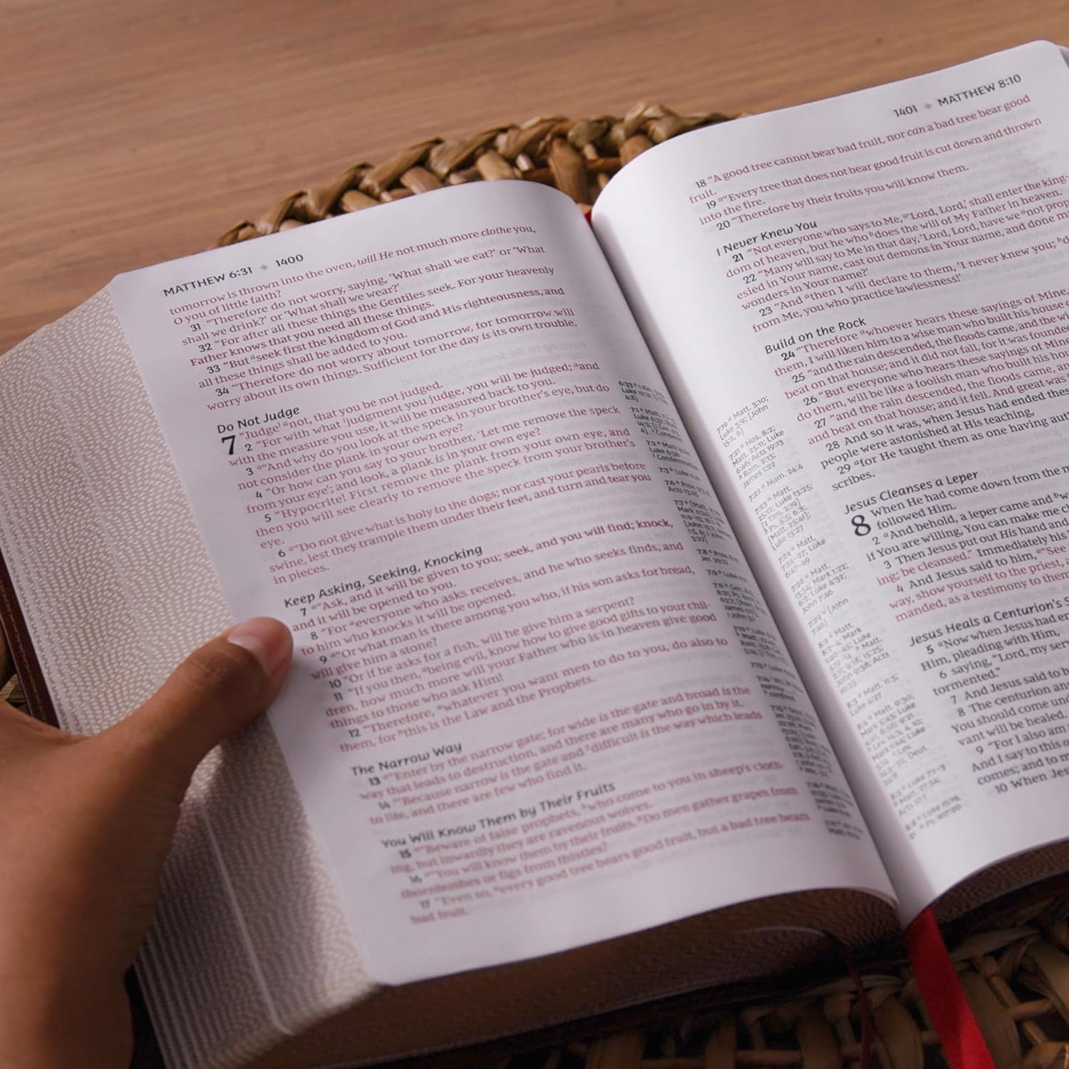
Summary
Unfortunately – people go back to God for a different answer
  Galatians 1:6-10
Preachers MUST proclaim “God’s Word”
  Ezekiel 3:17-21
  2 Corinthians 4:7-14
Conviction is needed
  1 Kings 22:8-9
  Acts 5:29
Richie Thetford www.thetfordcountry.com

