Slide 1
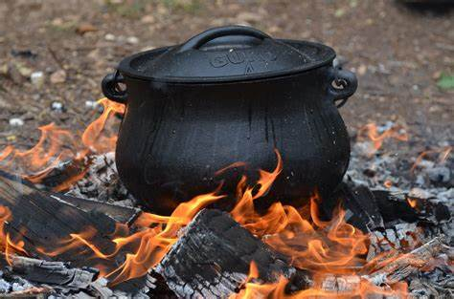
DEATH IN THE POT!
2 Kings 4:40

Slide 2
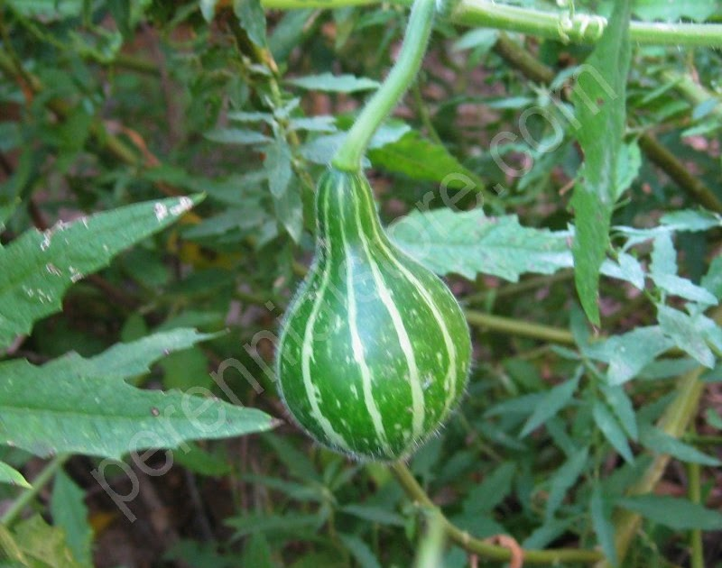
Practical Lessons
All herbs were good except one
Wild gourds poisoned all the good
1 Corinthians 5:6; Matthew 15:7-14
“Do not be deceived: Evil company corrupts good habits.”
1 Corinthians 15:33
Richie Thetford www.thetfordcountry.com

Slide 3

Poison Gourds of Today
Bad reading literature
Parents have a responsibility
Some books need to be burned!
Acts 19:19
Richie Thetford www.thetfordcountry.com

Slide 4
Poison Gourds of Today
Social Poison
Social drinking
1 Thes 5:21-22; Isaiah 5:11, 22; Proverbs 23:29-30
Evil movies
1 Timothy 4:12-16; 1 Peter 5:8; Philippians 4:8
Modern dance
Galatians 5:19-21; 1 Corinthians 15:33; 1 Thes 5:21-22
Richie Thetford www.thetfordcountry.com

Slide 5

Poison Gourds of Today
Religious Poison
Changed the truth into a lie
Romans 1:24-25
Denominationalism
All will be saved (Hebrews 5:9)
Baptism not essential (Romans 6:3-5; Acts 2:38)
Church membership not essential (Ephesians 5:23)
Can’t fall from grace (Galatians 5:4; Romans 11:22)
Richie Thetford www.thetfordcountry.com

Slide 6

Poison Gourds of Today
Religious Poison in the church
Hypocrites
1 Peter 2:1-2
Disinterest or Indifference
Heb 5:12-14; Rom 12:11; Rev 3:16
Worldliness
1 John 2:15-17; Romans 12:1-2
Richie Thetford www.thetfordcountry.com

Slide 7

Conclusion
Be content with only the truth!
1 Peter 4:11; John 8:32
Our lives should harmonize with truth
1 Peter 2:12; Matthew 5:16
Purge out the leaven of poison!
Holy
Bible
Richie Thetford www.thetfordcountry.com

