Slide 1
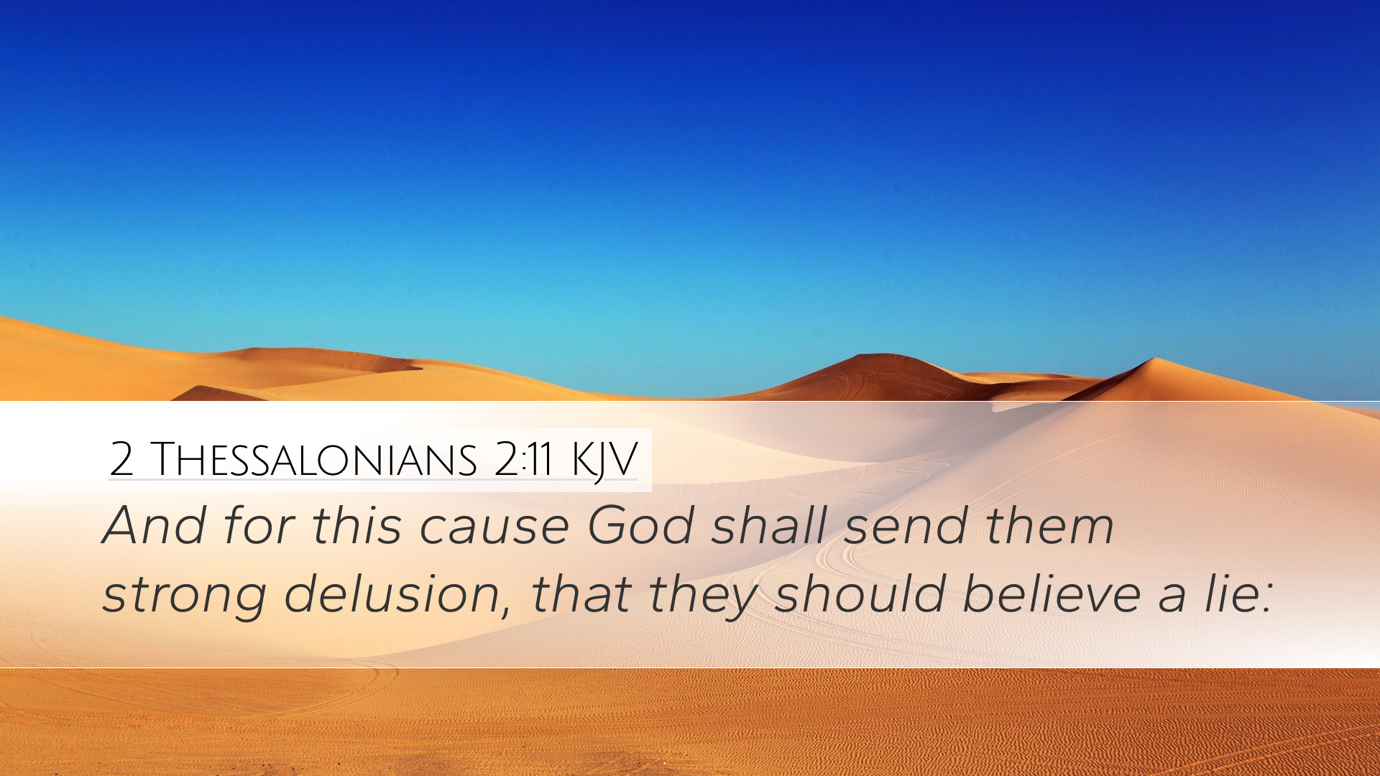
Don’t Believe a Lie!
Richard Thetford www.thetfordcountry.com

Slide 2

Each Thing We Hear is Either the Truth or a Lie
Truth comes from God
  John 14:6
Lying originated with the Devil
  John 8:44
Everything heard is accepted as
truth or a lie
  Hebrews 11:6
  Acts 17:11
Richard Thetford www.thetfordcountry.com

Slide 3

Each Thing We Hear is Either the Truth or a Lie
In the religious realm
  It is either true or false
We must heed:
  What we hear
    Mark 4:24; Romans 10:17
  How we hear
    Luke 8:18; Acts 10:33
  Whom we hear
    Matthew 17:5; Acts 3:22-23
Richard Thetford www.thetfordcountry.com

Slide 4

Lies, Believed as Truth, are Dangerous
Can cause the soul to be lost
  Proverbs 23:7
One may be filled with false doctrine
and not be receptive to the truth
Avoid either situation
  Matthew 5:8
Richard Thetford www.thetfordcountry.com

Slide 5
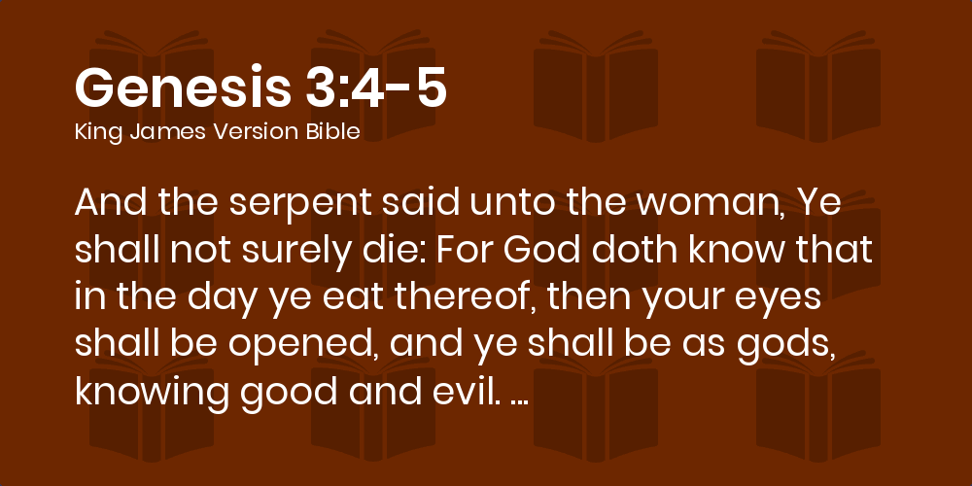
Bible Examples of Those Who Believed a Lie
Adam and Eve
  Genesis 3:1-6
Ten spies
  Numbers 13:25-33
The prophet of God
  1 Kings 13
Richard Thetford www.thetfordcountry.com

Slide 6

Satan Uses Lies to Cause People to Be Lost
Makes no difference what one believes
  Hebrews 5:9
  Matthew 7:21
One church is as good as another
  Acts 20:28
Baptism is not necessary for salvation
  Mark 16:16
  1 Peter 3:21
Richard Thetford www.thetfordcountry.com

Slide 7

Satan Uses Lies to Cause People to Be Lost
It is impossible to fall from grace
  1 Corinthians 10:12
  Romans 11:22
Not necessary to attend church services
  Hebrews 10:23-26
Don’t have to give as prospered
  1 Corinthians 16:1-2
  2 Corinthians 9:7
Richard Thetford www.thetfordcountry.com

Slide 8

Conclusion
Anything contrary to God’s word is a lie
  Galatians 1:6-8
Must strive to obey ALL of God’s will
Make sure that we are living our
lives for Christ!
Richard Thetford www.thetfordcountry.com

