Slide 1


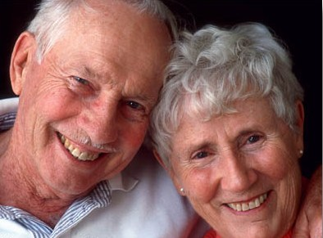
HAPPINESS IN THE LORD
“Happy is the man who is always reverent, but he who hardens his heart will fall into calamity.”
Proverbs 28:14
Richie Thetford www.thetfordcountry.com

Slide 2

Trusting in God
The Christian puts their trust in God
  Proverbs 3:5
  Proverbs 16:20
Richie Thetford www.thetfordcountry.com

Slide 3

Relishing the Scriptures
The Christian loves the Word of God
  Psalms 1:1-2
  Psalms 119:103
  Proverbs 29:18
The scriptures give hope, comfort,
and gladness
Richie Thetford www.thetfordcountry.com

Slide 4
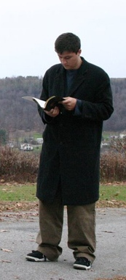
Living Righteously
The Christian loves to do the right thing
  Psalms 32:10-11
  Psalms 64:10
New Testament teaches what man must do
  Titus 2:12
  1 Peter 3:14
Richie Thetford www.thetfordcountry.com

Slide 5
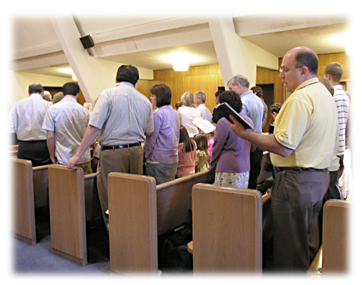
Worshiping God Regularly
Worship is a delight to every Christian
  Psalms 96:9-11
  Psalms 122:1
Worship is for the glory of God
and the happiness of man
Richie Thetford www.thetfordcountry.com

Slide 6

Keeping a Clean Conscience
The Christian knows the value of a
clean conscience
  Acts 24:16
  1 Timothy 1:19
There is much happiness to those who
can worship God with a pure conscience
Richie Thetford www.thetfordcountry.com

Slide 7
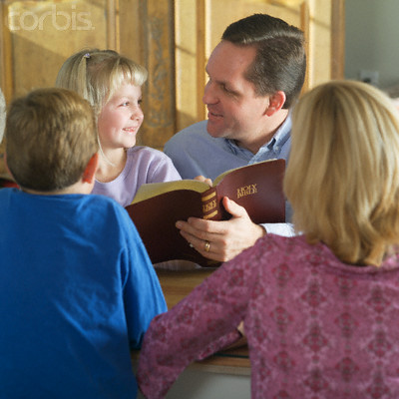
Staying Busy Constructively
The Christian knows that happiness comes to those who work persistently, consistently, and diligently
Effort and accomplishment bring inward pleasure
  1 Corinthians 15:58
Richie Thetford www.thetfordcountry.com

Slide 8
Christians are Happy Because They:
Trust in God
Relish the scriptures
Live righteously
Worship God regularly
Keep a clean conscience
Stay busy in constructive work
Richie Thetford www.thetfordcountry.com

