Slide 1
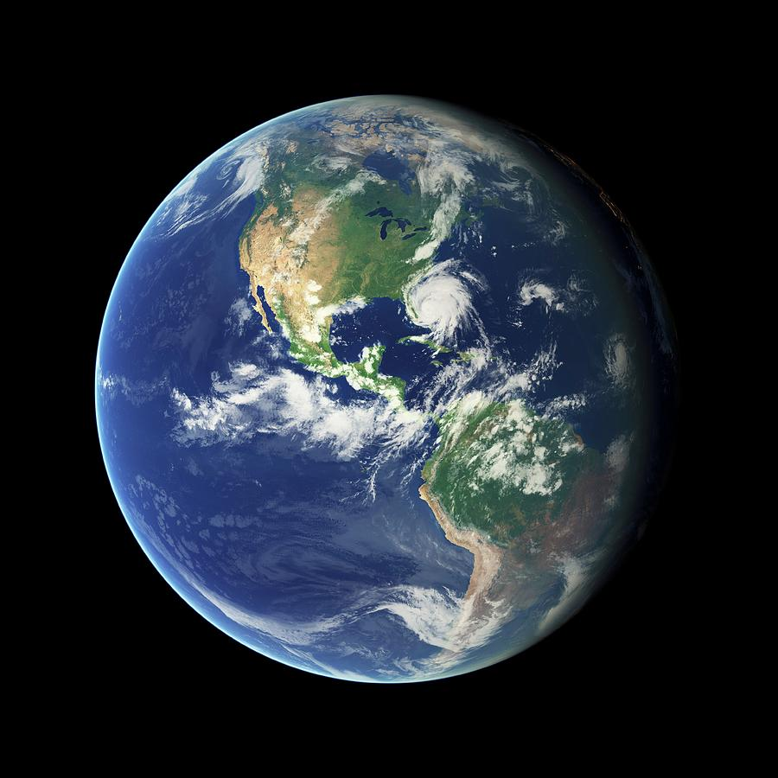


Our ONE Last Day
Luke 12:13-21
Richie Thetford www.thetfordcountry.com

Slide 2

The Parable
About a farmer
  Luke 12:16
The question
  Luke 12:17-19
The answer
  Luke 12:20
Not rich toward God
  Luke 12:21
Richie Thetford www.thetfordcountry.com

Slide 3
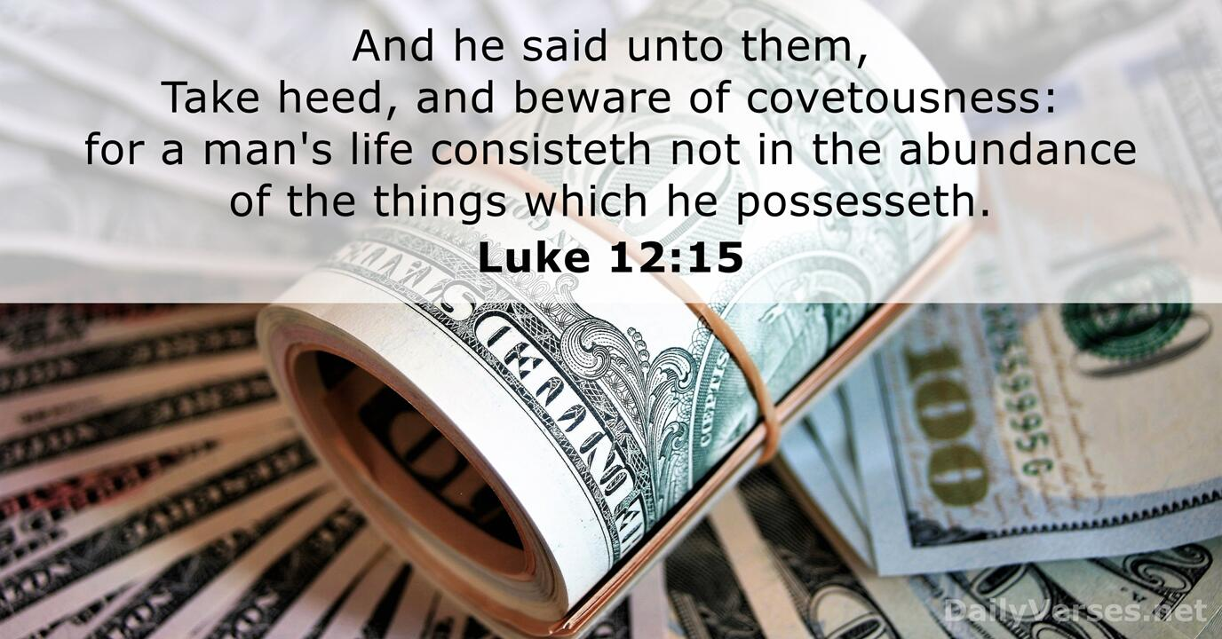
Covetousness
Life consists more than “things”
  Luke 12:13-15
Be content
  Hebrews 13:5-6
Love of money
  1 Timothy 6:6-10
Richie Thetford www.thetfordcountry.com

Slide 4

Death is Coming
“this night”
  Luke 12:20
Life is like a vapor
  James 4:13-17
Death is certain
  Ecclesiastes 8:8; 9:2-3
  1 Thessalonians 4:15-18
Richie Thetford www.thetfordcountry.com

Slide 5

Set Our House in Order
“we shall die”
  2 Kings 20:1-6
Put on Christ
  Ephesians 1:7; Galatians 3:26-27
Be diligent
  2 Peter 1:10-11
Press on every day!
  Philippians 3:13-14
Be prepared to meet God
Richie Thetford www.thetfordcountry.com

