Slide 1
Seeing Ourselves
As God Sees Us!
“For I say, through the grace given to me, to everyone who is among you, not to think of himself more highly than he ought to think, but to think soberly, as God has dealt to each one a measure of faith.”
Romans 12:3
Richie Thetford www.thetfordcountry.com

Slide 2

Thinking
“too little”
of ourselves
Thinking
“too much”
of ourselves
“If the foot should say, "Because I am not a hand, I am not of the body," is it therefore not of the body? And if the ear should say, "Because I am not an eye, I am not of the body," is it therefore not of the body?
1 Corinthians 12:15-16
“And the eye cannot say to the hand, I have no need of you; nor again the head to the feet, I have no need of you.”
1 Corinthians 12:21
Richie Thetford www.thetfordcountry.com

Slide 3

Learn to see ourselves as God sees us
“And there is no creature hidden from His sight, but all things are naked and open to the eyes of Him to whom we must give account.”
Hebrews 4:13
Richie Thetford www.thetfordcountry.com

Slide 4
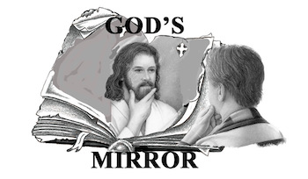
Our Nature
Made in God’s image
  Genesis 1:27
Persons – not things
We have dignity and honor
  God’s created child
Richie Thetford www.thetfordcountry.com

Slide 5
Our Sins
Attitude of David
  Psalms 26:2
  Psalms 139:1
  Psalms 139:23-24
Need God’s help to see our sins as they really are
  Psalms 19:12-13
Presumptuous
– too bold or forward; showing overconfidence; taking liberties
Richie Thetford www.thetfordcountry.com

Slide 6
Our Weaknesses
All have unique strengths and weaknesses
Look at self and others “below the surface”
  1 Samuel 16:7
  2 Corinthians 5:16
And Strengths
Richie Thetford www.thetfordcountry.com

Slide 7
Our Worth
Our Potential
People have more “value” than other creatures
  Matthew 6:26
  Matthew 10:29-31
God sees possibilities
  Others may also!
  Revelation 3:8
Richie Thetford www.thetfordcountry.com

Slide 8
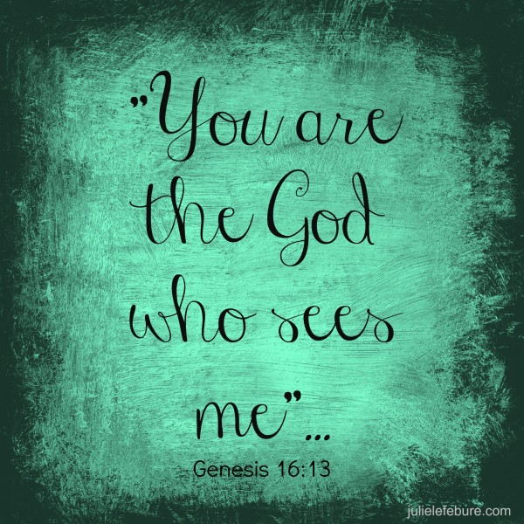
God Sees:
✓ What we have been
✓ What we are
✓ What we can be!
We need to see ourselves as those whom God chose to redeem “with the precious blood of Christ”
1 Peter 1:18-19
Learn to see ourselves as God sees us!
Richie Thetford www.thetfordcountry.com

