Slide 1

Richard Thetford www.thetfordcountry.com

Slide 2
Adam and Eve
Genesis 2:16-17; 3:1-6
Moses
Hebrews 11:23
Joshua
Joshua 24:15
Richard Thetford www.thetfordcountry.com

Slide 3

We Must Choose Between Right and Wrong
”For before the Child shall know to refuse the evil
and choose the good, the land that you dread
will be forsaken by both her kings.”
Isaiah 7:16
“Moreover, your little ones and your children,
who you say will be victims, who today have no knowledge
of good and evil, they shall go in there; to them I will give it, and they shall possess it.”
Deuteronomy 1:39
Richard Thetford www.thetfordcountry.com

Slide 4
We Must Choose Between Right and Wrong
”For though by this time you ought to be teachers,
you need someone to teach you again the first principles
of the oracles of God; and you have come to need milk
and not solid food. For everyone who partakes only of milk
is unskilled in the word of righteousness, for he is a babe.
But solid food belongs to those who are of full age,
that is, those who by reason of use have their senses exercised to discern both good and evil.
Hebrews 5:12-14
dd
Richard Thetford www.thetfordcountry.com

Slide 5
We Must Choose Between Right and Wrong
”But he who does wrong will be repaid for what
he has done, and there is no partiality.”
Colossians 3:25
There is a need for us to read and study our Bible to be able to KNOW and to DO that which is right.
Richard Thetford www.thetfordcountry.com

Slide 6

Choose the God of the Bible
”And Elijah came to all the people, and said,
“How long will you falter between two opinions?
If the LORD is God, follow Him; but if Baal, follow him.”
But the people answered him not a word.
1 Kings 18:21
”And if it seems evil to you to serve the LORD, choose for yourselves this day whom you will serve, whether the gods which your fathers served that were on the other side of the River, or the gods of the Amorites, in whose land you dwell. But as for me and my house, we will serve the LORD.”
Joshua 24:15
Richard Thetford www.thetfordcountry.com

Slide 7
Choose the God of the Bible
“You shall have no other gods before Me.”
Exodus 20:3
”Then Jesus said to him, "Away with you, Satan!
For it is written, 'YOU SHALL WORSHIP THE LORD
YOUR GOD, AND HIM ONLY YOU SHALL SERVE.”
Matthew 4:10
Richard Thetford www.thetfordcountry.com

Slide 8
Choose the God of the Bible
“….one Lord, one faith, one baptism;”
Ephesians 4:5
”for in Him we live and move and have our being,
as also some of your own poets have said,
For we are also His offspring.”
Acts 17:28
Richard Thetford www.thetfordcountry.com

Slide 9
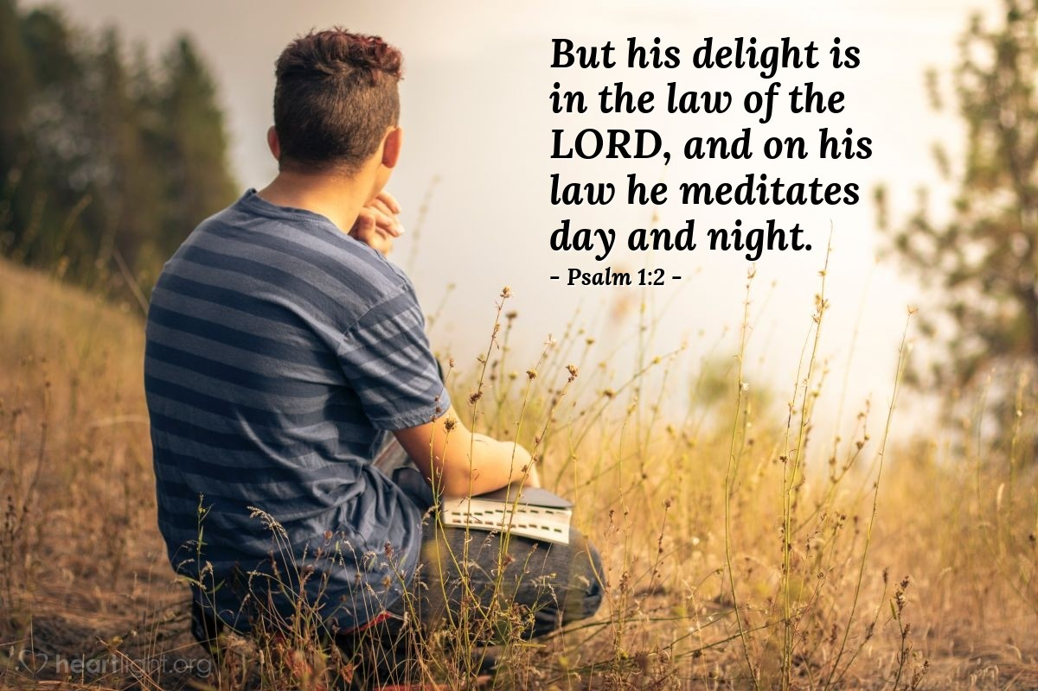
Choose the Good Part
That which is pleasing to God
  Luke 10:38-42
  Acts 13:7
  Romans 10:17
  Acts 11:14
  James 1:21
Our “delight” should be in the Lord
  Psalms 1
Richard Thetford www.thetfordcountry.com

Slide 10
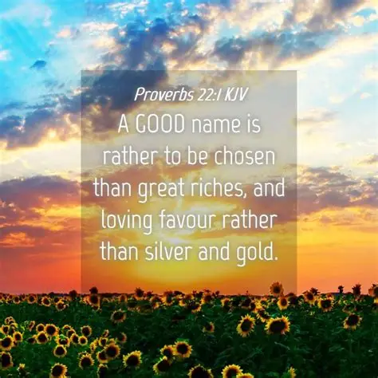

Choose a Good Name
It is valuable and precious
  Proverbs 22:1
  Acts 11:26
  James 2:7
Richard Thetford www.thetfordcountry.com

Slide 11
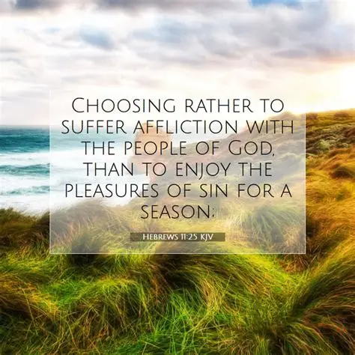
Choose to Serve God Over Pleasures
Pleasures come and go
  Hebrews 11:23-28
Richard Thetford www.thetfordcountry.com

Slide 12

Choices Which Determine our Destiny
Two gates: Broad and Straight
Two ways: Wide and Narrow
Two groups: Many and Few
Two destinies: Destruction or Life
Two foundations: Rock and Sand
  Matthew 7:21-27
Two kinds of righteousness: Man’s and God’s
  Romans 10:1-3
Richard Thetford www.thetfordcountry.com

Slide 13
For He says: “IN AN ACCEPTABLE TIME I HAVE HEARD YOU, AND IN THE DAY OF SALVATION I HAVE HELPED YOU.” Behold, now is the accepted time; behold, now is the day of salvation.
2 Corinthians 6:2
Richard Thetford www.thetfordcountry.com

