Slide 1
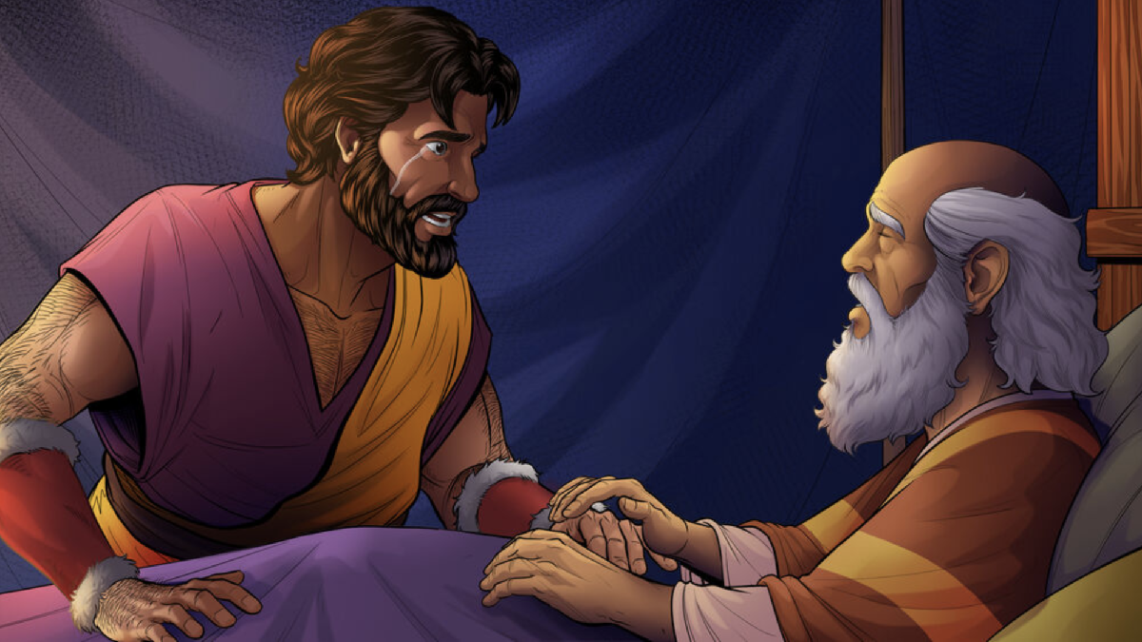
Esau’s Tears
Genesis 25:23-34
Richie Thetford www.thetfordcountry.com

Slide 2
Birthright
The right which naturally belonged to the firstborn son
Consisted of a double portion of what the father left behind
Became head of the family
  Responsible for younger sons, widow or widows, unmarried daughters
Consider amount of authority over other members
Placed him in close and favored covenant relationship with God
All these gifts and privileges could be diverted from the
firstborn son. This could happen with his own consent,
as in the case with Esau. He sold his birthright to Jacob
Richie Thetford www.thetfordcountry.com

Slide 3
Overview
Jacob receives his father’s blessing
  Genesis 27:1-17
“Esau’s Tears”
  Genesis 27:38
  Hebrews 12:14-17
“Esau’s tears”
in a sense, represents lost things, things not regainable
Richie Thetford www.thetfordcountry.com

Slide 4
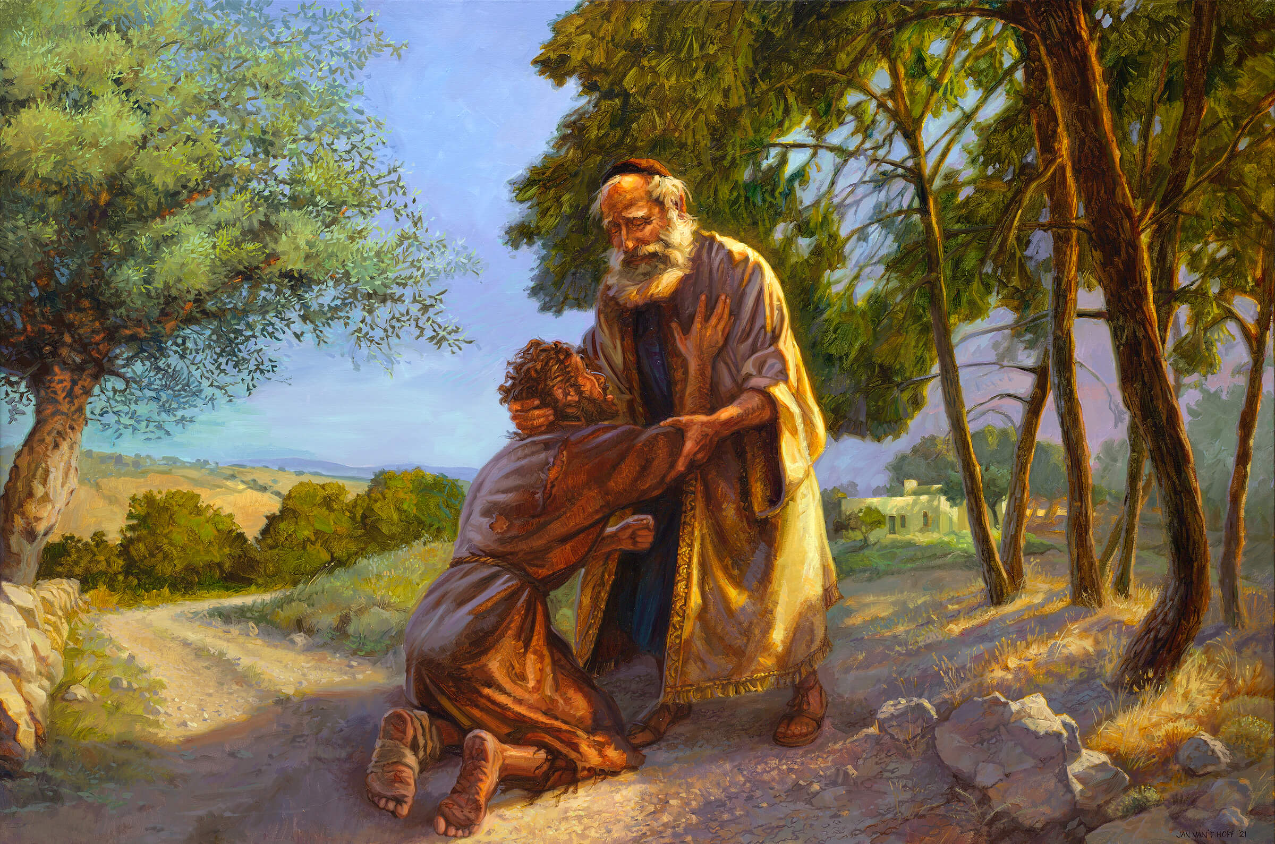
Bible Examples of Esau’s Tears
Adam and Eve
Cain
  Genesis 4:9-13
Samson
Prodigal Son
Judas Iscariot
  Matthew 27:3-5
Richie Thetford www.thetfordcountry.com

Slide 5
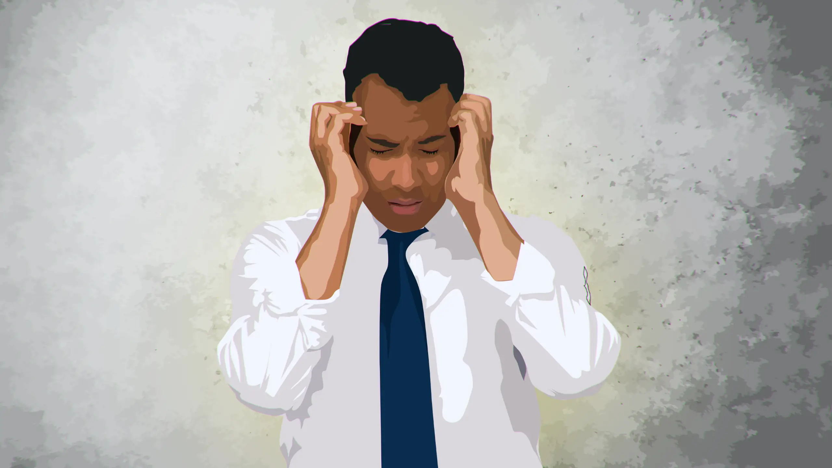
Esau’s Tears (Physical Realm)
Many things cannot be regained
Money
Health
  1 Corinthians 6:19-20
Job opportunities
Parents missing out on their
child’s childhood
Richie Thetford www.thetfordcountry.com

Slide 6
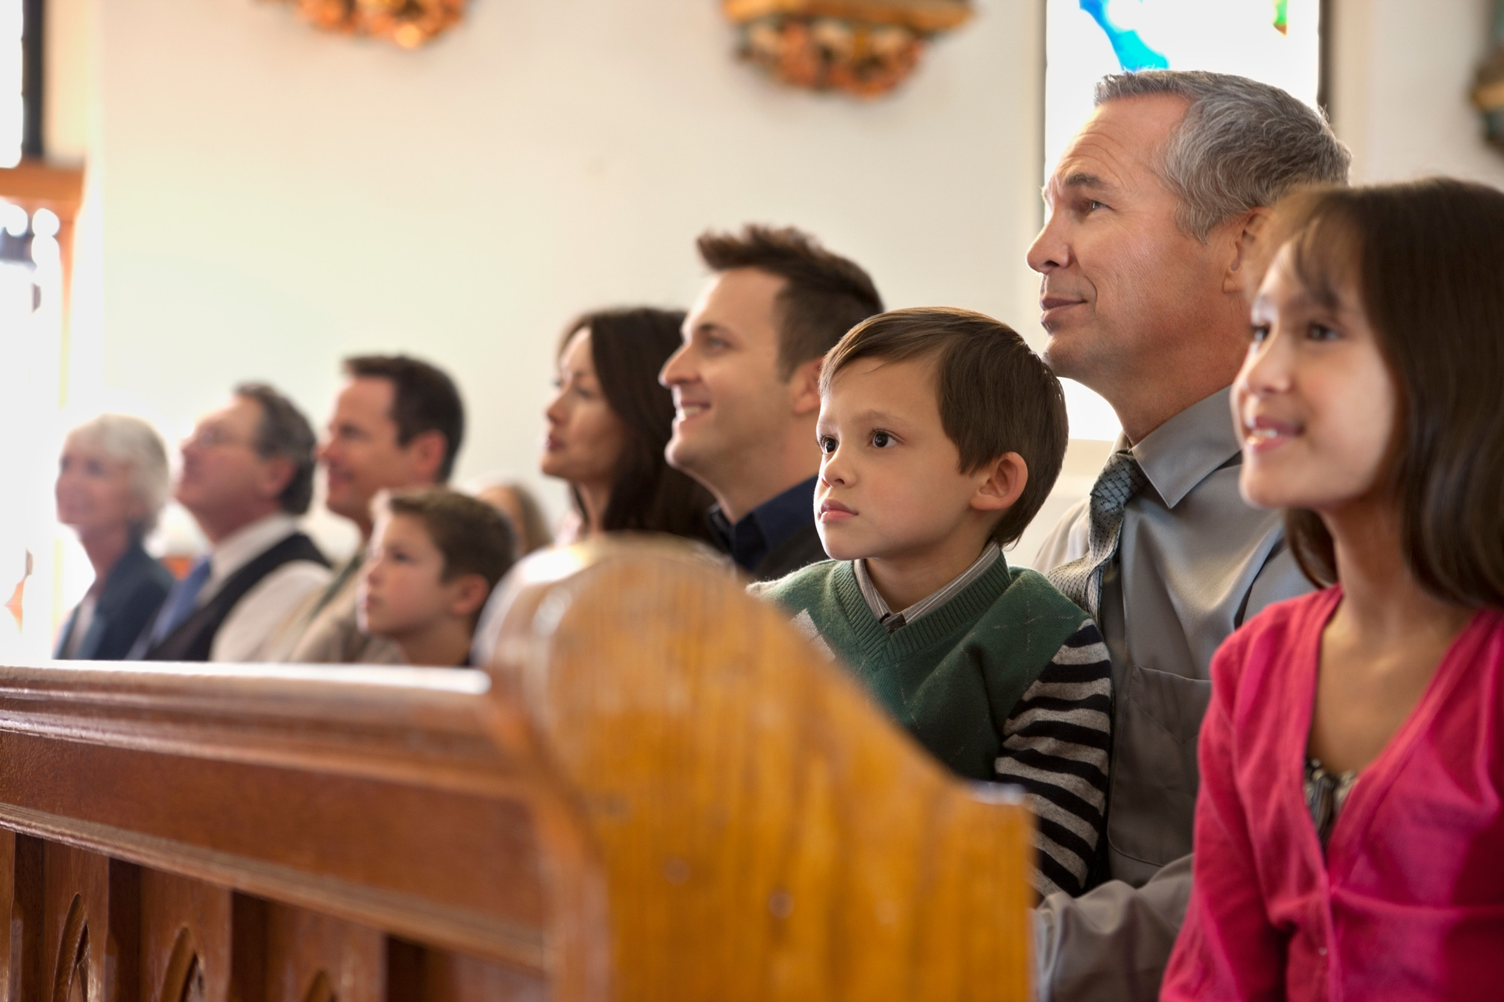
Esau’s Tears (Spiritual Realm)
Church gets on the wrong track
Doing things without Authority
  Colossians 3:17
Membership without
repentance
  2 John 9
Lack of church discipline
  1 Corinthians 5:6
Richie Thetford www.thetfordcountry.com

Slide 7

Esau’s Tears – Our Greatest Loss
Some spiritual things can never be regained
Name, influence, reputation
  Proverbs 22:1
  Matthew 5:13-16
Wrong choice for a mate
  Matthew 6:33
Opportunity to teach others
Opportunity to obey the gospel of Christ
  Luke 16:24-26
Richie Thetford www.thetfordcountry.com

Slide 8
Conclusion
Make sure your life is
“right with God”
For He says:
“IN AN ACCEPTABLE TIME
I HAVE HEARD YOU,
AND IN THE DAY OF SALVATION
I HAVE HELPED YOU.”
Behold, now is the accepted time;
behold, now is the day of salvation.
2 Corinthians 6:2
Richie Thetford www.thetfordcountry.com

