Slide 1

Ephesians 2:1-10
Richie Thetford www.thetfordcountry.com

Slide 2


What Is God’s Grace?
“unmerited favor” – God giving us what we don’t deserve
  Romans 3:23-24
  Titus 2:11-14
Richie Thetford www.thetfordcountry.com

Slide 3

The Source of Grace
Begins with God the Father
  John 3:16
Continues with Jesus Christ
  John 1:14
  John 1:17
Included in the Holy Spirit
  Titus 3:5-7
Richie Thetford www.thetfordcountry.com

Slide 4

The Purpose of Grace
To save us
  Titus 2:11
  Ephesians 2:8
To justify us
  Romans 3:24
To sanctify us
  Titus 2:12
Richie Thetford www.thetfordcountry.com

Slide 5

The Purpose of Grace
To strengthen us
  2 Corinthians 12:9
To equip us
  1 Peter 4:10
Richie Thetford www.thetfordcountry.com

Slide 6

The Power and Character of Grace
Grace is unmerited – cannot be earned
  Romans 11:6
Grace is abundant – it is greater than all sin
  Romans 5:20
Grace is transforming – it changes
who we are
  2 Corinthians 5:17
Richie Thetford www.thetfordcountry.com

Slide 7

The Power and Character of Grace
Grace is sufficient – it meets every need
  2 Corinthians 12:9
Richie Thetford www.thetfordcountry.com

Slide 8
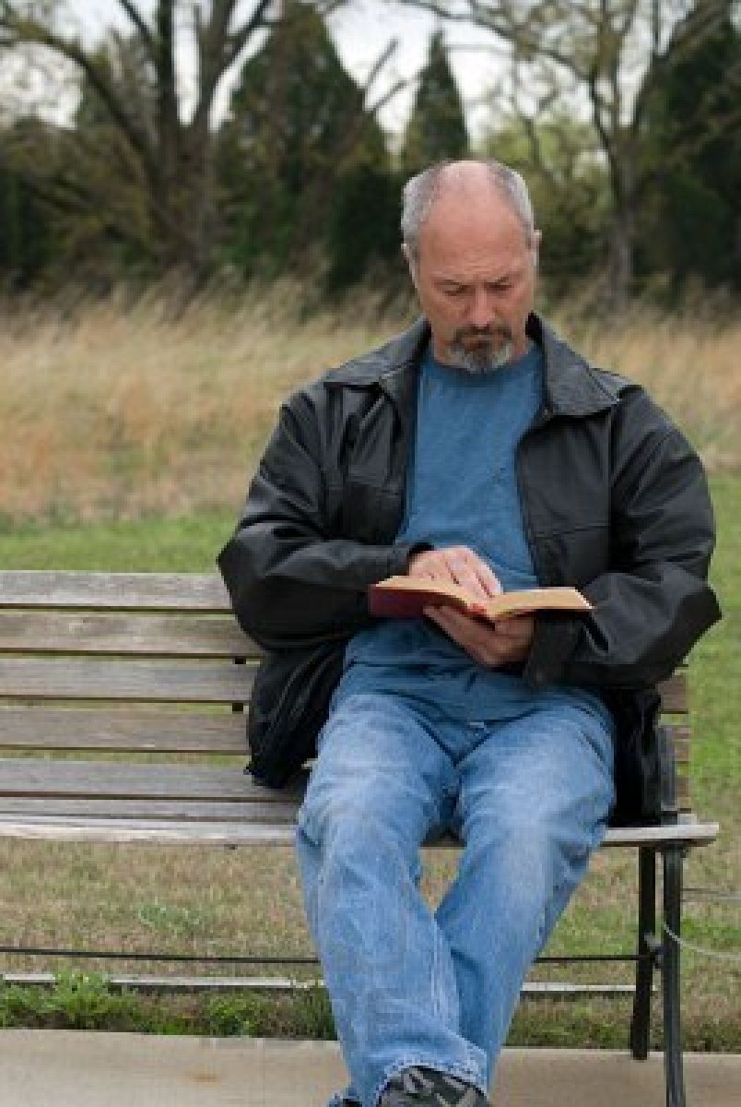
Our Response to God’s Grace
In our faith – receiving it through trust
  Romans 5:1-2
In our obedience – living according to it
  Romans 6:1-4
In our humility – acknowledging dependence
  James 4:6
Richie Thetford www.thetfordcountry.com

Slide 9

Our Response to God’s Grace
In our service – using grace to serve others
  1 Corinthians 15:10
Richie Thetford www.thetfordcountry.com

Slide 10

The Results of Grace
A new life in Christ
  2 Corinthians 5:17
Have peace with God
  Romans 5:1-2
Eternal hope
  2 Thessalonians 2:16
Richie Thetford www.thetfordcountry.com

Slide 11

The Results of Grace
Continue to gain spiritual growth
  2 Peter 3:18
Richie Thetford www.thetfordcountry.com

Slide 12
Have you received God’s grace through obedient faith in Jesus Christ?
Ephesians 2:1-10
Richie Thetford www.thetfordcountry.com

