Slide 1

I Met a Friend of Mine Today
Matthew 27:45-54
Richard Thetford www.thetfordcountry.com

Slide 2
In the Streets of Jerusalem
Saints raised from the grave
  Matthew 27:50-53
Christ was first to rise
  1 Corinthians 15:20
Rich man and Lazarus
  Luke 16:27-31
God’s power to bring life from death
  Ezekiel 37:12-13
  Isaiah 26:19
A sign of Christ’s victory
1 Corinthians 15:20-23
Torn Veil: Access to God through Christ
Earthquake: Creation and death respond to the creator
Raised saints: Foretaste and testimony of Christ’s victory over death
Richard Thetford www.thetfordcountry.com

Slide 3
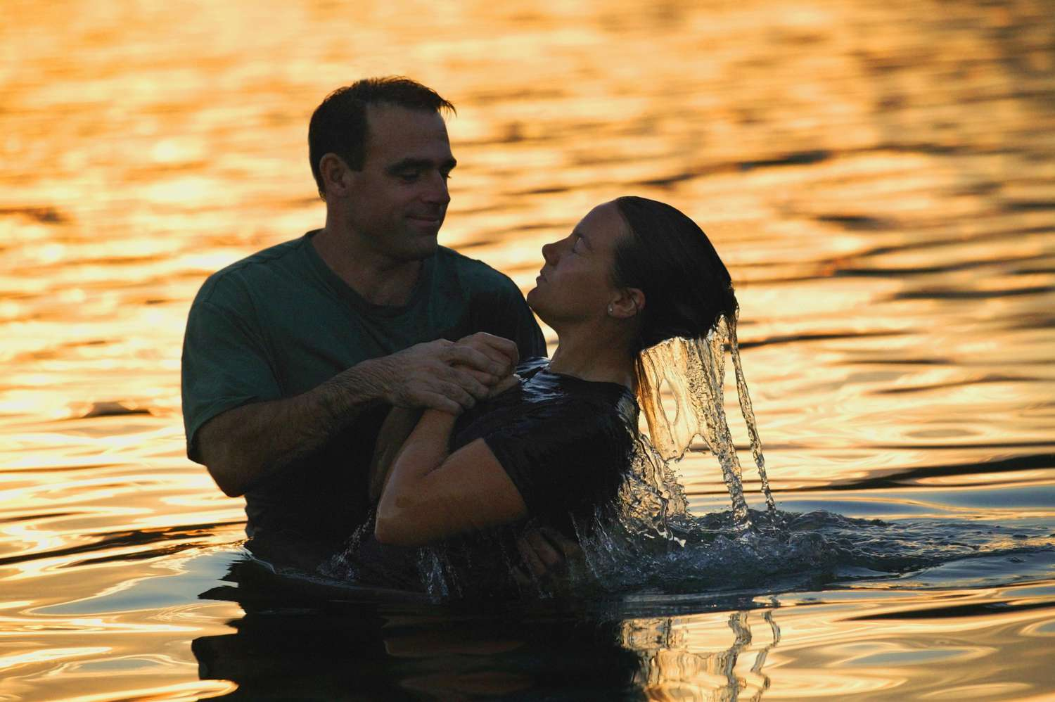
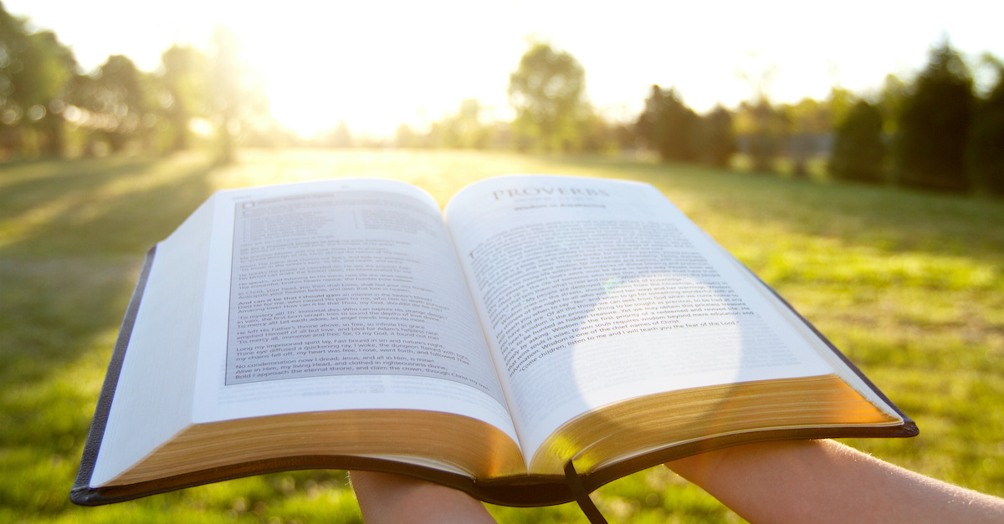
When I Arose from the Watery Grave of Baptism
When we become children of God
  John 1:12; Amos 3:3; John 15:14
When we love and obey Him
  Hebrews 5:9; John 15:13-15
  Galatians 3:26-27
Friendship Sustained
by abiding in Him
  1 John 1:3; John 15:4-5
Richard Thetford www.thetfordcountry.com

Slide 4
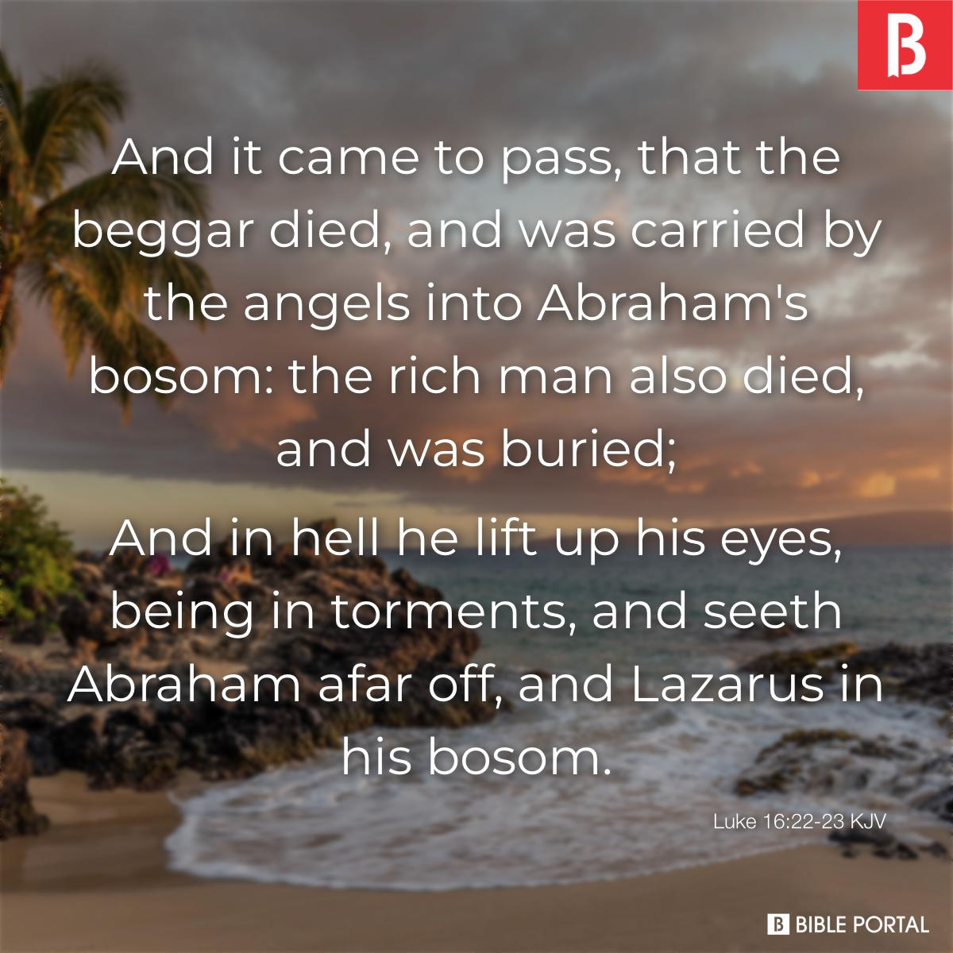
When I Died and Saw My Friend in Paradise
Rich man and Lazarus
  Luke 16:19-26
Disciples recognized Moses and Elijah
  Matthew 17:1-4
Jesus promised fellowship in His kingdom
  Matthew 8:11
Richard Thetford www.thetfordcountry.com

Slide 5
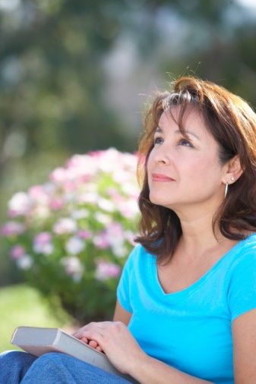
When I Was Resurrected and Met Jesus in the Air
Total Excitement!
  1 Thessalonians 4:13-18
  Daniel 12:2
After Jesus’ resurrection – still Jesus
  Luke 24:39
Mary recognized Jesus after His resurrection
  John 20:16
We’ll be changed – but still be ourselves
  1 Corinthians 15:42-44
Richard Thetford www.thetfordcountry.com

Slide 6
I Met a Friend of Mine Today
We should be longing to meet Jesus – our true FRIEND!
In the resurrection, we will not be less than we are now
– we will be more than we have ever been!
Perfected in Christ our Lord!
Richard Thetford www.thetfordcountry.com

