Slide 1
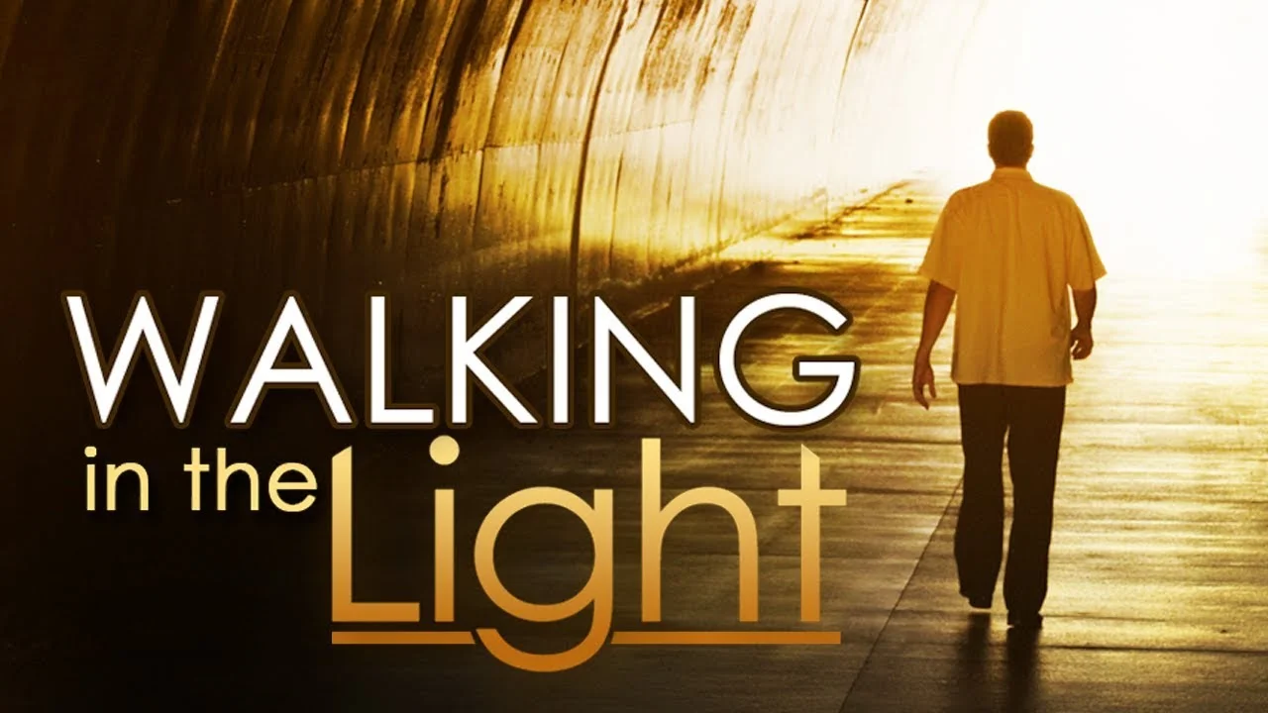
1 John 1:5-10
Richie Thetford ww.thetfordcountry.com

Slide 2

The Meaning of Walking in the Light
To live according to God’s
revealed truth
  John 8:12
  Psalms 119:105
“Your word is a lamp to my feet And a light to my path”
Psalms 119:105.
Richie Thetford ww.thetfordcountry.com

Slide 3
The Source of Light
God is light
  1 John 1:5
Jesus -- light of the world
  John 8:12
God’s word gives light
  Psalms 119:130
“This is the message which we have heard from Him and declare to you, that God is light and in Him is no darkness at all.”
1 John 1:5
Richie Thetford ww.thetfordcountry.com

Slide 4
The Benefits of Walking in the Light
Benefits:
  1 John 1:6-7
    To be in the proper
    fellowship with God
    To have fellowship
    with others
    To be cleansed from sins
“But if we walk in the light as He is in the light, we have fellowship with one another, and the
blood of Jesus Christ His Son
cleanses us from all sin.”
1 John 1:7
Richie Thetford ww.thetfordcountry.com

Slide 5
The Challenge of Walking in the Light
The world loves darkness
  John 3:19
Many temptations
  Compromise
  Hypocrisy
  Spiritual laziness
“And this is the condemnation, that the light has come into the world, and men loved darkness rather than light, because
their deeds were evil.”
John 3:19
Richie Thetford ww.thetfordcountry.com

Slide 6
How to Walk in the Light Daily
Stay in the word
  Psalms 119:105; 1:1-2
Pray continually
  1 Thessalonians 5:17
Confess sins
  1 John 1:9
“If we confess our sins, He is faithful and just to forgive us
our sins and to cleanse us
from all unrighteousness.”
1 John 1:9
Richie Thetford ww.thetfordcountry.com

Slide 7
How to Walk in the Light Daily
Stay in fellowship
  Hebrews 10:24-25
Reflect Christ’s light
  Matthew 5:14-16
“Let your light so shine before men, that they may see your good works and glorify
your Father in heaven.”
Matthew 5:16
Richie Thetford ww.thetfordcountry.com

Slide 8
The Reward of Walking in the Light
Assurance, peace,
eternal life!
  Proverbs 4:18
  Revelation 21:23-24
As we walk in the light,
the clearer our path
“But the path of the just is like the shining sun, That shines ever brighter unto the perfect day.”
Proverbs 4:18
Richie Thetford ww.thetfordcountry.com

Slide 9
Leave behind the shadows
of sin and walk boldly
in the light of Christ 24/7!
1 John 1:5-10
Richie Thetford ww.thetfordcountry.com

