Slide 1
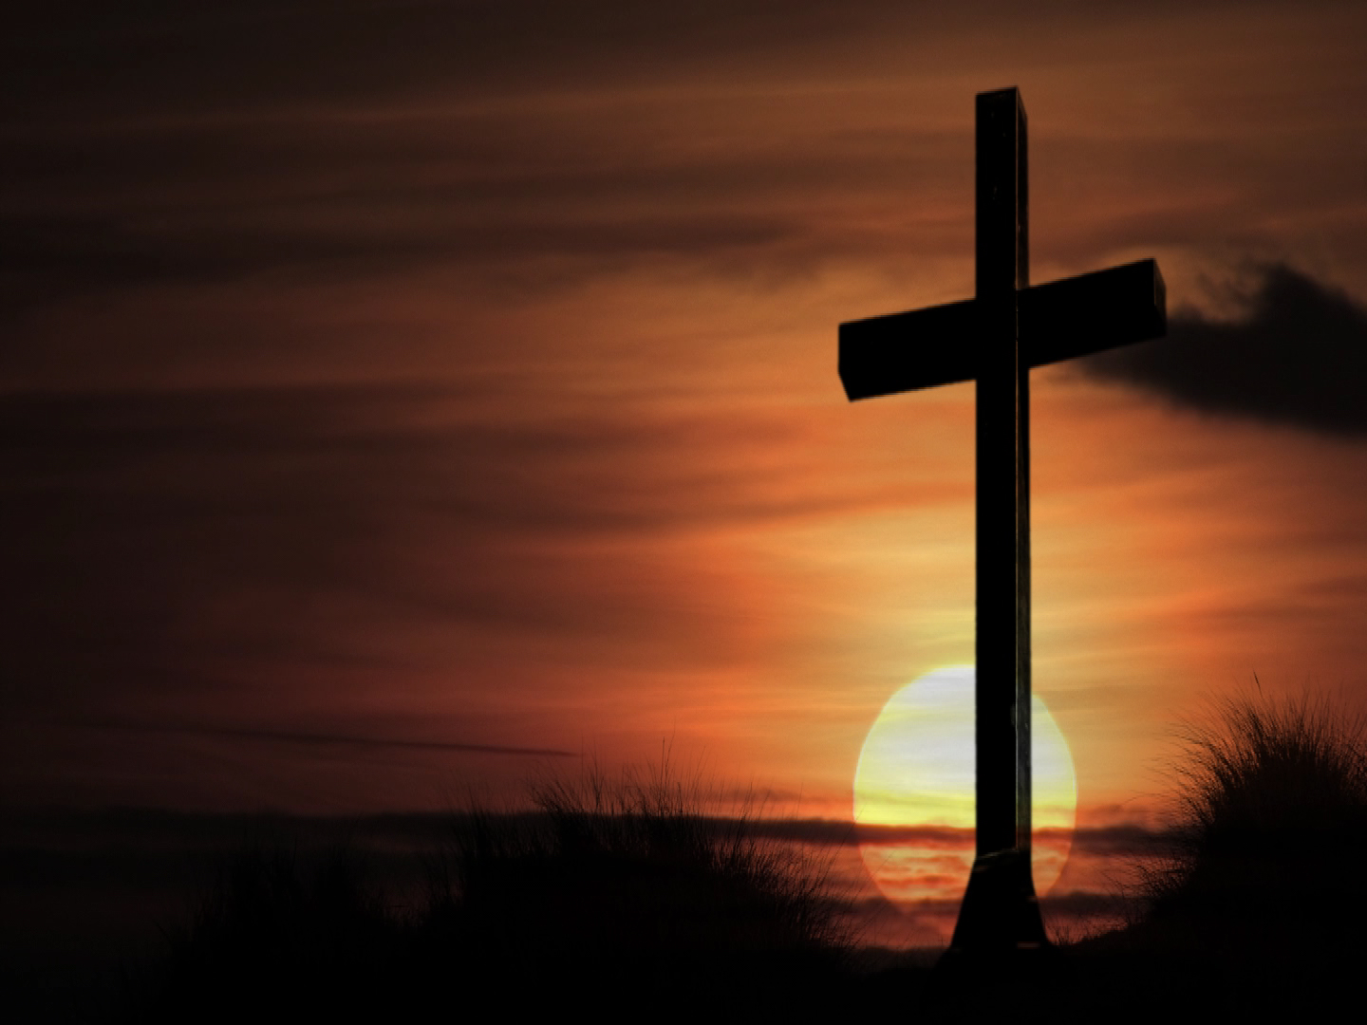
Because He Lives
John 14:19
Song # 353
“He Lives” (Verses 1-2 only)
Opening Prayer
Richie Thetford www.thetfordcountry.com

Slide 2
I AM REDEEMED
Ephesians 2:11-22
Song # 552
“Living for Jesus”
Luke 24:1-12
Song # 411
“Redeemed”
Richie Thetford www.thetfordcountry.com

Slide 3
THERE IS PEACE AND HOPE
2 Corinthians 4:8-18
Song # 626
“It Is Well with My Soul”
1 Corinthians 15:12-26
Song # 174
“Christ Arose”
Richie Thetford www.thetfordcountry.com

Slide 4
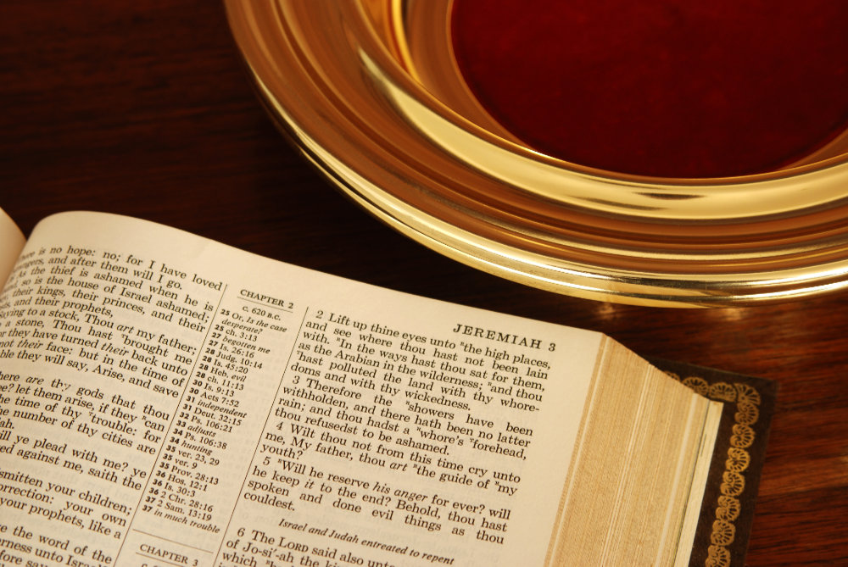
COLLECTION
Song # 340
“I Gave My Life for Thee”
Richie Thetford www.thetfordcountry.com

Slide 5
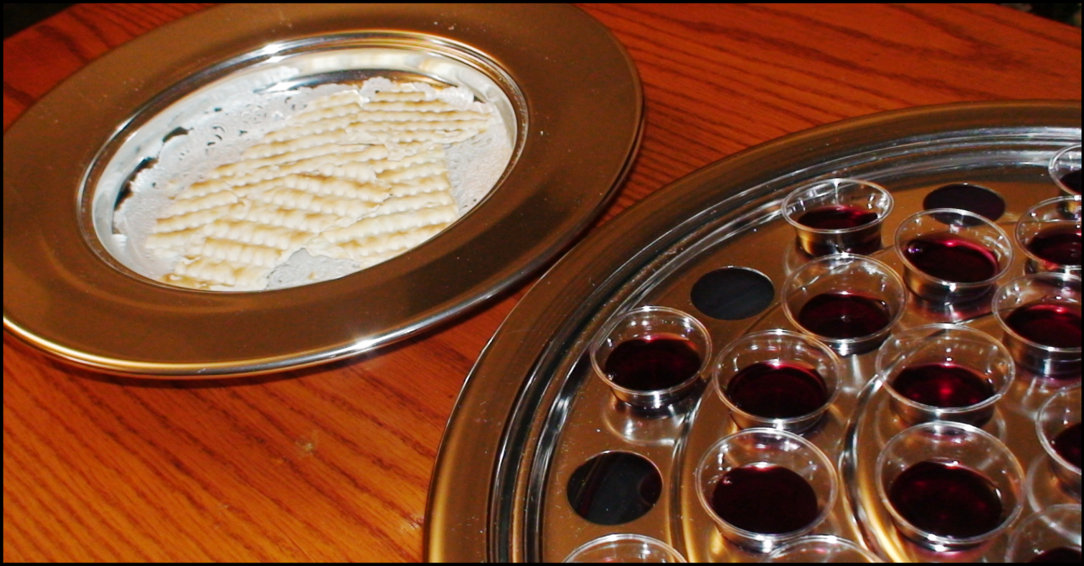
LORD’S SUPPER
Song # 152
“By Christ Redeemed”
Hebrews 2:5-18
Richie Thetford www.thetfordcountry.com

Slide 6
DEATH’S STING IS GONE
John 11:30-36
1 Corinthians 15:50-57
Song # 359
“Victory in Jesus”
Psalms 116:1-19
Song # 522
“When the Roll is Called Up Yonder”
Richie Thetford www.thetfordcountry.com

Slide 7
LIFE IS WORTH LIVING
John 10:1-10
Song # 391
“Savior, Like a Shepherd Lead Us”
Richie Thetford www.thetfordcountry.com

Slide 8
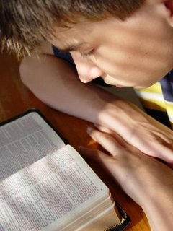
INVITATION
Invitation Lesson
Invitation Song # 293
“Come to Jesus Today”
Closing Song # 353
“He Lives”
(Verse 3 only)
Closing Prayer
Richie Thetford www.thetfordcountry.com

