Slide 1

Psalm 73:28
Richard Thetford www.thetfordcountry.com

Slide 2

Psalm 73:28
Song: 328 (Handout)
“Nearer, My God, to Thee”
Opening Prayer
Richard Thetford www.thetfordcountry.com

Slide 3

DESIRE TO BE NEARER TO GOD
James 4:7-10
Song: 28
“Is It For Me?”
Psalm 28:1-7; Hebrews 7:11-19
Song: 125
“Nearer, Still Nearer”
Richard Thetford www.thetfordcountry.com

Slide 4

NEARER TO GOD IN OUR FUTURE PATHS
John 14:1-6
Song: 335
“Live for Jesus”
Jeremiah 29:8-13
Song: 160
“One Day”
Richard Thetford www.thetfordcountry.com

Slide 5
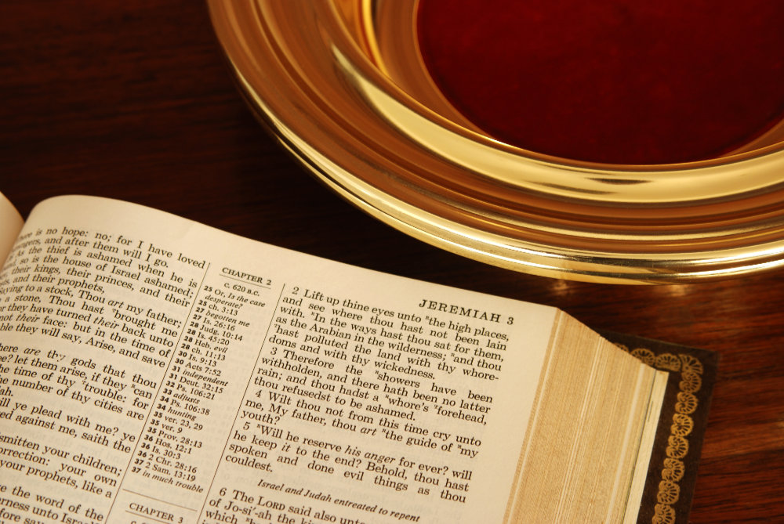
COLLECTION
Song: 392
“Count Your Blessings”
Richard Thetford www.thetfordcountry.com
Richard Thetford www.thetfordcountry.com

Slide 6
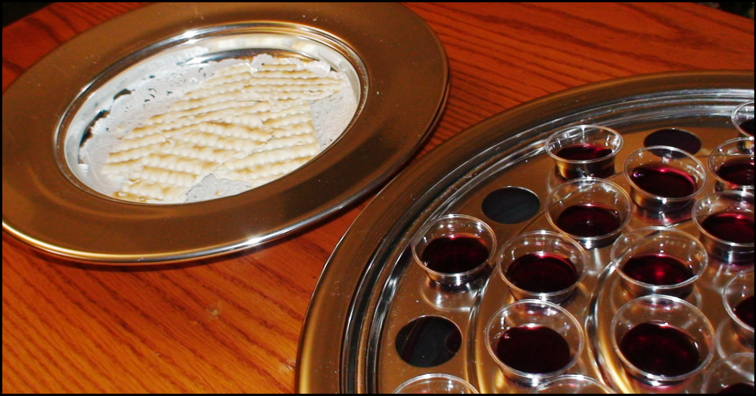
LORD’S SUPPER
Song: 154
“Near the Cross”
Matthew 26:38-45
Richard Thetford www.thetfordcountry.com

Slide 7
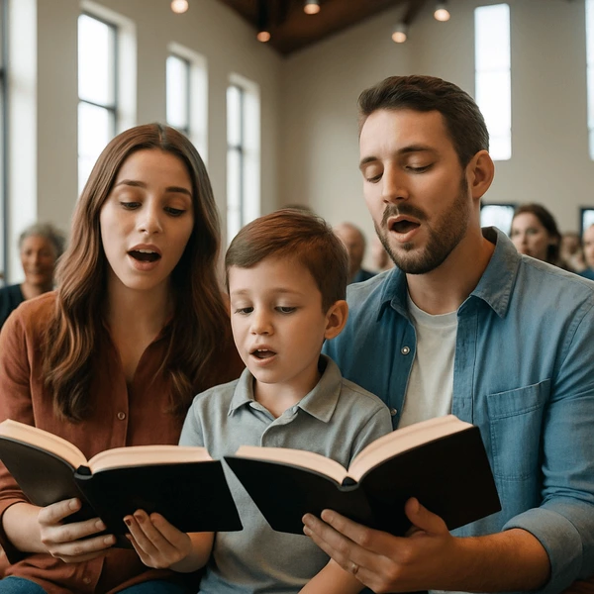
PRAISE TO GOD AND ETERNITY WITH HIM
Psalm 5:1-12; James 1:1-12
Song: 13
“Alleluia”
Luke 16:19-31; 1 Thes 4:13-18
Song: 532
“We Shall See the King Some Day”
Richard Thetford www.thetfordcountry.com

Slide 8

NEARER, MY GOD, TO THEE
INVITATION LESSON
Invitation Song: 347
“Who Will Follow Jesus?”
Closing Prayer
Richard Thetford www.thetfordcountry.com

Slide 9
Psalm 73:28
Richard Thetford www.thetfordcountry.com

